Slide 1
Next Generation Data Infrastructures: From Data Dumps to Data Services
Andreas Rauber
Information & Software Engineering Research Group, Institute of Information Systems Engineering, Faculty of Informatics - TU Wien

Slide 2
Outline
Thing achieved so far
The continuoing evolution of research
New challenges and requirements for Data Infrastructures
Some examples and next steps

Slide 3
Achievements
Awareness!
Policies
Repositories to dump files
Metadata standards to describe them
Digital preservation concepts and processes
Knowing that planning helps: Data Management Plans
We can be proud
We should be happy…

Slide 4
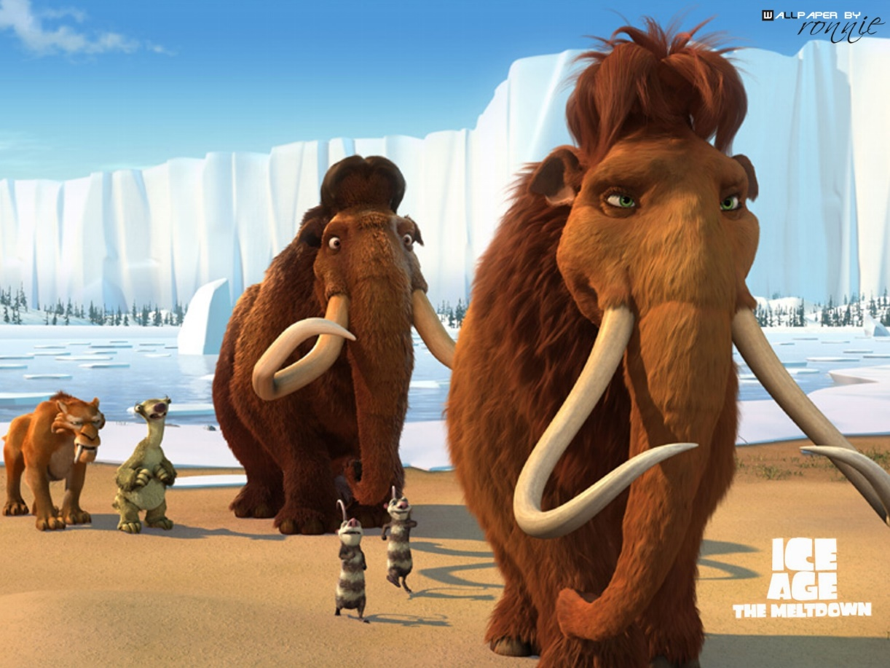
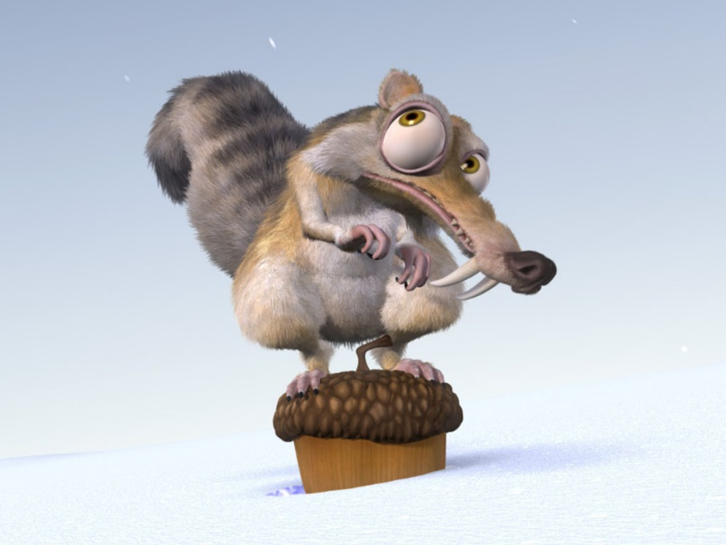
Achievements
Awareness!
Policies
Repositories to dump files
Metadata standards to describe them
Digital preservation concepts and processes
Knowing that planning helps: Data Management Plans
We can be proud
We should be happy…
… but the world is changing

Slide 5
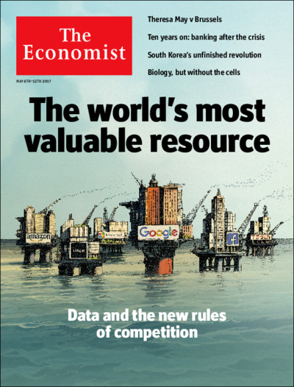
Big Data
Data as “the new oil”…
… or “the new water”…
… or “the new light”….
The Economist, May 6 2017
https://www.economist.com/printedition/2017-05-06

Slide 6
Big Data
What is “Big Data”?
Lot’s of data … really a lot…. but not only this…
Lot’s of V’s
V
V
V
V
V
V
V
V
V
V
V
V
V
V

Slide 7
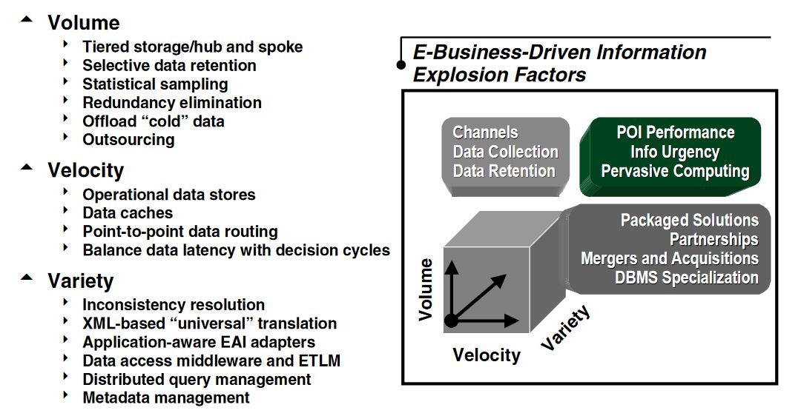
Big Data - 3 V’s
3 V’s: Doug Laney, 3D Data Management: Controlling Data Volume, Velocity, and Variety, META-Group, 2001 https://blogs.gartner.com/doug-laney/files/2012/01/ad949-3D-Data-Management-Controlling-Data-Volume-Velocity-and-Variety.pdf

Slide 8
Big Data - 4 V’s
4 V’s: Oracle Whitepaper, 2013 https://www.oracle.com/technetwork/topics/entarch/articles/info-mgmt-big-data-ref-arch-1902853.pdf
Image from: Arockia Panimalar, Varnekha Shree, Veneshia Kathrine: The 17 V’s Of Big Data, IRJET 4(9):329-333, 2017.

Slide 9
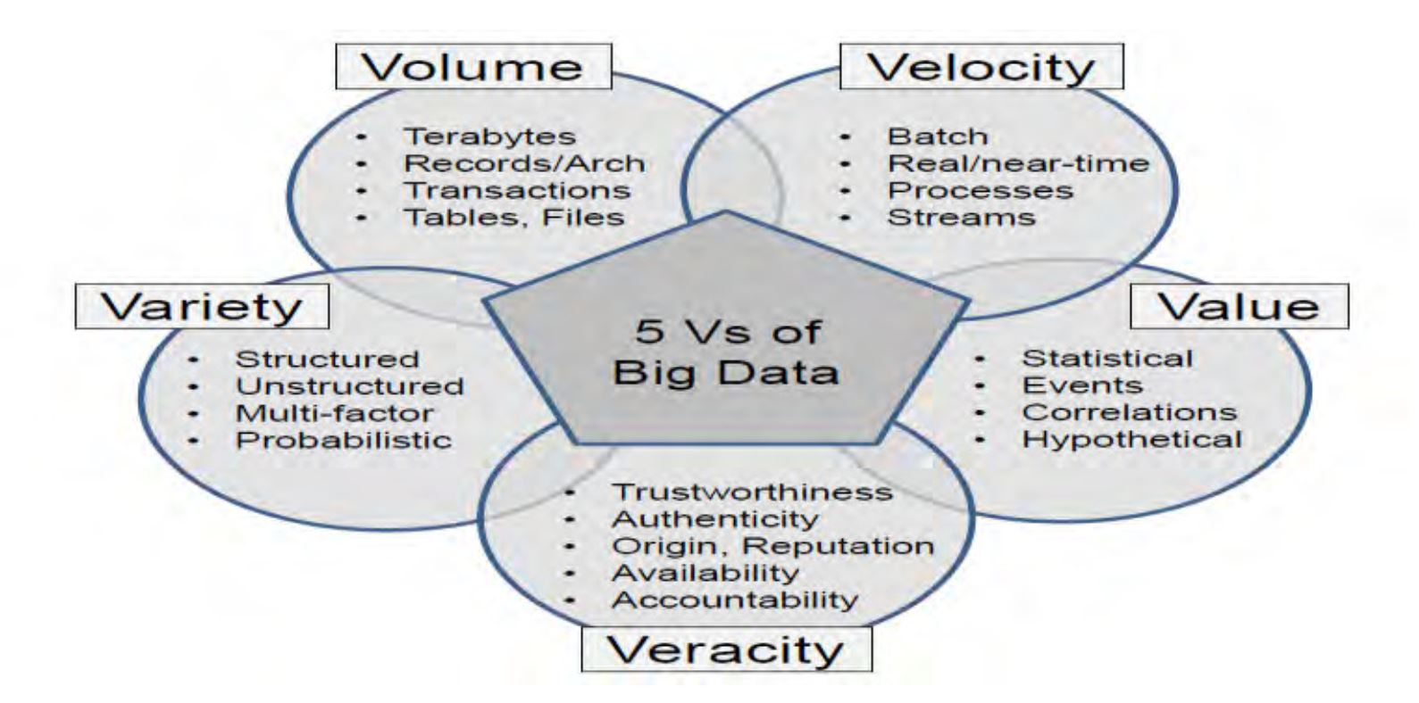
Big Data – 5 V’s
5 V’s:
Image from: Ishwarappa, Anuradha: A Brief Introduction on Big Data 5Vs Characteristics and Hadoop Technology, ICC 2015, doi:10.1016/j.procs.2015.04.188

Slide 10
Big Data – 10 V’s
10 V’s: Kirk Borne, Blog-Post, April 11 2014. https://mapr.com/blog/top-10-big-data-challenges-serious-look-10-big-data-vs/
Image from: Arockia Panimalar, Varnekha Shree, Veneshia Kathrine: The 17 V’s Of Big Data, IRJET 4(9):329-333, 2017.

Slide 11
Evolving Research
“All” research data-driven
Research increasingly interdisciplinary
Big data requirements start occurring across all disciplines
Expectations of research community are changing
Timely data, live data
Historic data
FAIRness (interdisciplinary!)
Reproducibility
…

Slide 12
Challenges for Researchers
Discipline-specific repositories, not useable by non-domain experts
Small benchmark data, dumps of files live data, big data etc. only within specialized infrastructures in some domains
Research work requires increasingly specialized skills in computing (databases, python, visualization tools, workflow systems, …)
Even if those skills are mastered: more skill needs follow: Infrastructure management, Database management, IT Security, Legal requirements (GDPR, Licenses), …

Slide 13
Challenges for Researchers
Discipline-specific repositories, not useable by non-domain experts
Small benchmark data, dumps of files live data, big data, … only within specialized infrastructures in some domains
Research work requires increasingly specialized skills in computing (databases, python, visualization tools, workflow systems…)
Even if those skills are mastered: more skill needs follow: Infrastructure management, Database management, IT Security, Legal requirements (GDPR, Licenses), …
What does this mean for Data Infrastructures?
Which uses cases in Data Management should we take a look at?

Slide 14
Impact on Research Infrastructures
Need to realize that achievements so far were only first step
Need to drastically change the scope, focus, ambition
Data Services tightly integrated in research process
Used continuously on a daily basis, performing key functionalities …
… but should be invisible (more on this later)
Some examples
Data Citation
Data Management Planning

Slide 15
Data Citation
How it used to be
Static data files being uploaded to repository
DOI (ideally – rarely!) assigned and cited
Research today and tomorrow
Massive volumes of data
Highly dynamic data
Researchers working with subsets
Automated analysis processes

Slide 16
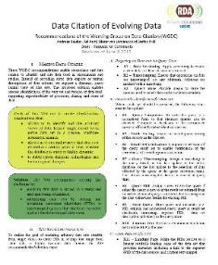
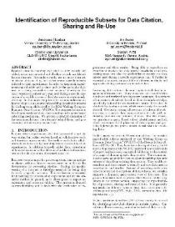
Data Citation
Current state of the art
Recommendation of the RDA WG on Dynamic Data Citation (Bulletin of IEEE TCDL, 12(1), 2016 http://www.ieee-tcdl.org/Bulletin/v12n1/papers/IEEE-TCDL-DC-2016_paper_1.pdf
Timestamping and versioning of databases
Assign PID to timestamped query, cite these
Next steps
PID used as input parameter to processes
Automated meta-studies, reasoning via data used, …
Citations are for machines!
Content negotiation? Semantics?

Slide 17
Data Management Planning
How it used to be
PhD student performs research
Collects data, processes it, stores it, does back-up (ideally)
Once finished hands over PC to next person, explaining what data is to be found where (ideally – rarely?)
Research today and tomorrow
Large, interdisciplinary teams
Huge volume of data
Massive costs of (pre-)processing
Requirements towards reproducibility, data re-use

Slide 18
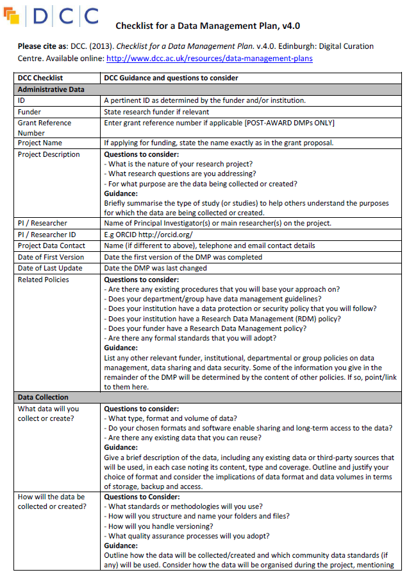
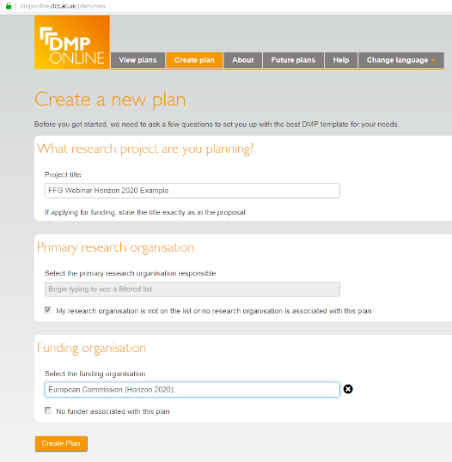
Data Management Planning
Current state of the art
Data Management Plans as PDF documents
Tool support to create these
Researchers annoyed about yet another non-research document
Nobody knows what to do with them afterwards
Next steps
Machine-actionable data management plans
Pre-filled by policies, infrastructure, …
Taking automatic action
RDA Working Group on DMP Common Standards (Tomasz Miksa)

Slide 19
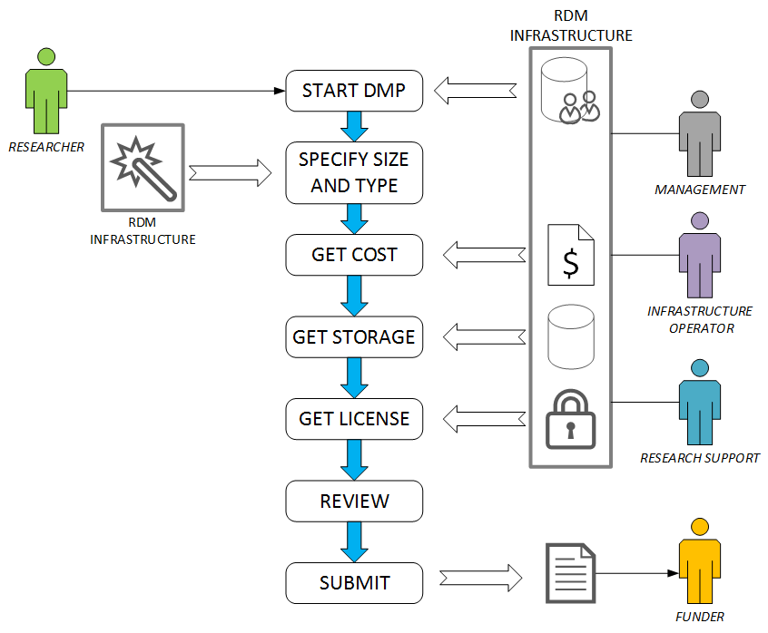
Data Management Planning
Machine actionable DMPs
"dc:creator":[ {
"foaf:name":"John Smith",
"@id":"orcid.org/0000-1111-2222-3333",
"foaf:mbox":"mailto:jsmith@tuwien.ac.at",
"madmp:institution":"AT-TU-Wien"
} ],

Slide 20
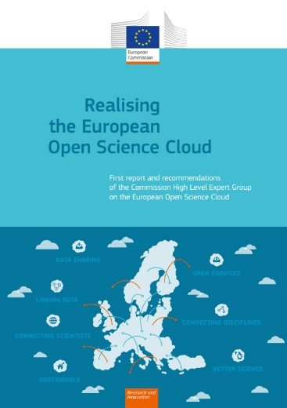
Data Services
Many more examples like these
Across the entire spectrum of the research process
Not just technical
Legal advice, Ethical advice
Statistics support
Development teams as research support
We need to be creative!!!
We need to dare to think beyond the current state of the art
The timing is right: EOSC!

Slide 21
What is the EOSC?
My own, unofficial, private, short answer:

Slide 22
What is the EOSC?
My own, unofficial, private, short answer:
… for research data and services
Transparent for the researcher
Federated, global system, based on minimal, open, rigorously implemented standards
Internet for data and services

Slide 23
November 2018 – Launch of the EOSC This is what we need to build now! How?

Slide 24
Data Services
We need to be creative!!!
We need to dare to
think beyond the current state of the art
envisage how research will be performed in 10 years
develop solutions that nobody request right now
be willing to give up services developed so far
understand that the role of data infrastructures will be completely different
Remember: the world is changing!
Let’s start brainstorming!

Slide 25
Data is the new oil
David J Carr Strategy Director. ex-CD, Planning Director & Head of UX @ DigitasLBi, DIG, Publicis, Chemistry & JWT. Jan 2017
https://startupsventurecapital.com/data-is-the-new-oil-dirty-misunderstood-polluting-the-world- pulled-from-all-the-wrong-places-72f33a5da434

Slide 26
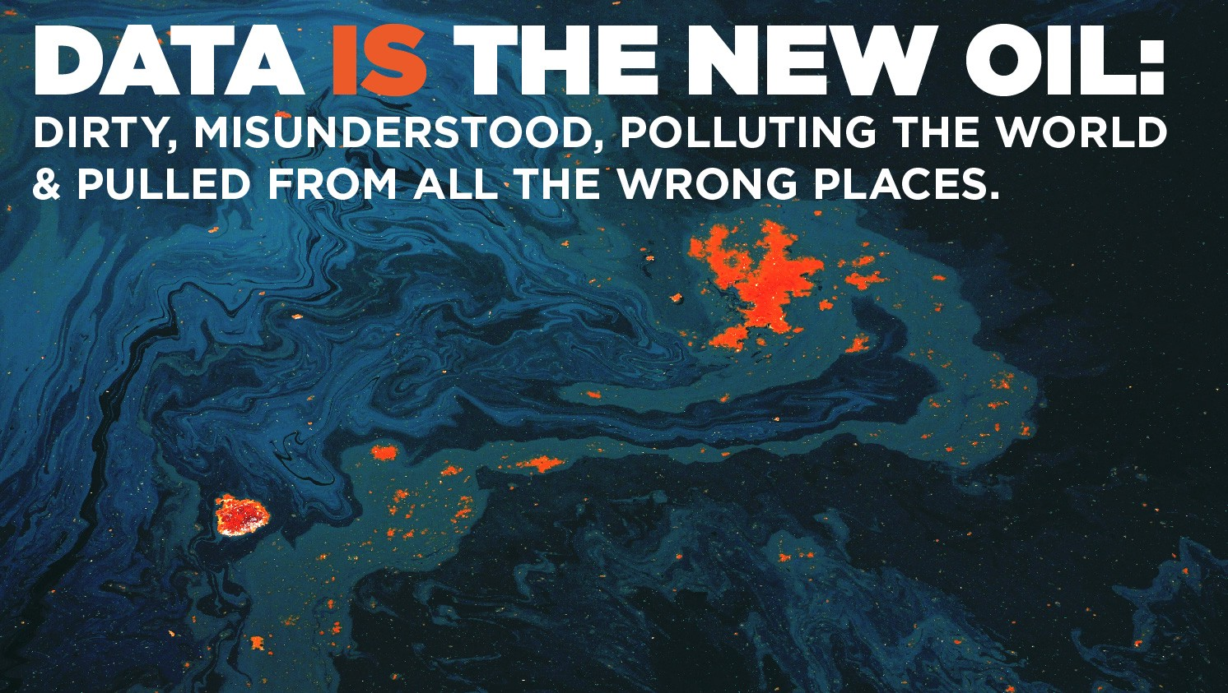
Data is the new oil
David J Carr Strategy Director. ex-CD, Planning Director & Head of UX @ DigitasLBi, DIG, Publicis, Chemistry & JWT. Jan 2017
https://startupsventurecapital.com/data-is-the-new-oil-dirty-misunderstood-polluting-the-world- pulled-from-all-the-wrong-places-72f33a5da434

Slide 27
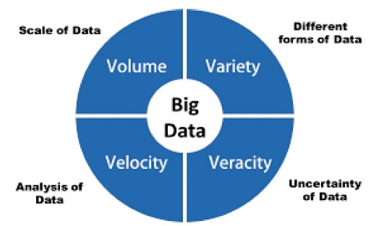
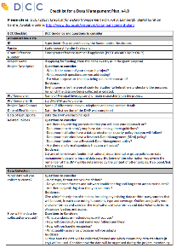
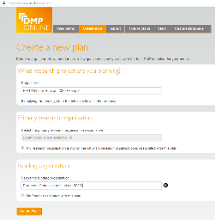
Thank you!

