Slide 1
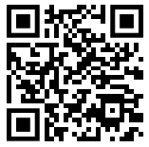
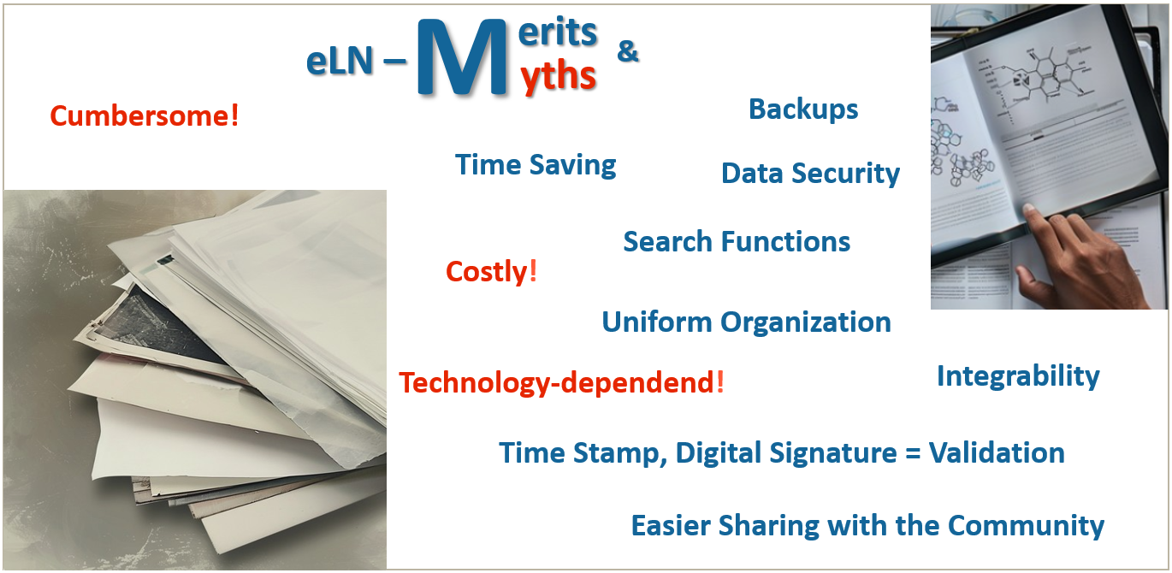
eLN – electronic Lab Notebook
Have you ever searched for data in a lab notebook from three years ago, when the colleague who now can no longer be contacted was still there? Digging through your colleague's unfamiliar handwriting, only to realize that the storage location of the information you want is written in a cryptic sentence that could mean something like “my lab USB stick”? No?
Either way - that wouldn't have happened with an electronic Lab Notebook!
eLN – Merits & Myths. No further explanation needed (...and if so: Contras on the left in orange, pros on the right in blue). Graphic was created using two AI-generated images from the Public Domain of stockcake.com.
Usage Structures at Universities
The IT department typically sets up one (or, more rarely, several) servers that are maintained, updated and secured by daily backups within the university. Such a server can only be accessed via the university's internal network using a web browser, for example. In this case, the data remains with the university and the same storage rules generally apply as for the network drives. New teams for editing lab books are usually authorised by RDM Support.
Basis for most eLNs are database systems accessible through a web application.
There are different roles with ascending authorisations: User, Admin, SysAdmin. Read and write authorisations can be assigned independently of this.
Correct on- and off-boarding of users is a crucial part of Good Scientific Practices (GSP) and prevents a lab group from pitfalls caused by unclear organization or data loss later on.
https://forschungsdaten.at/sharedrdm

Slide 2
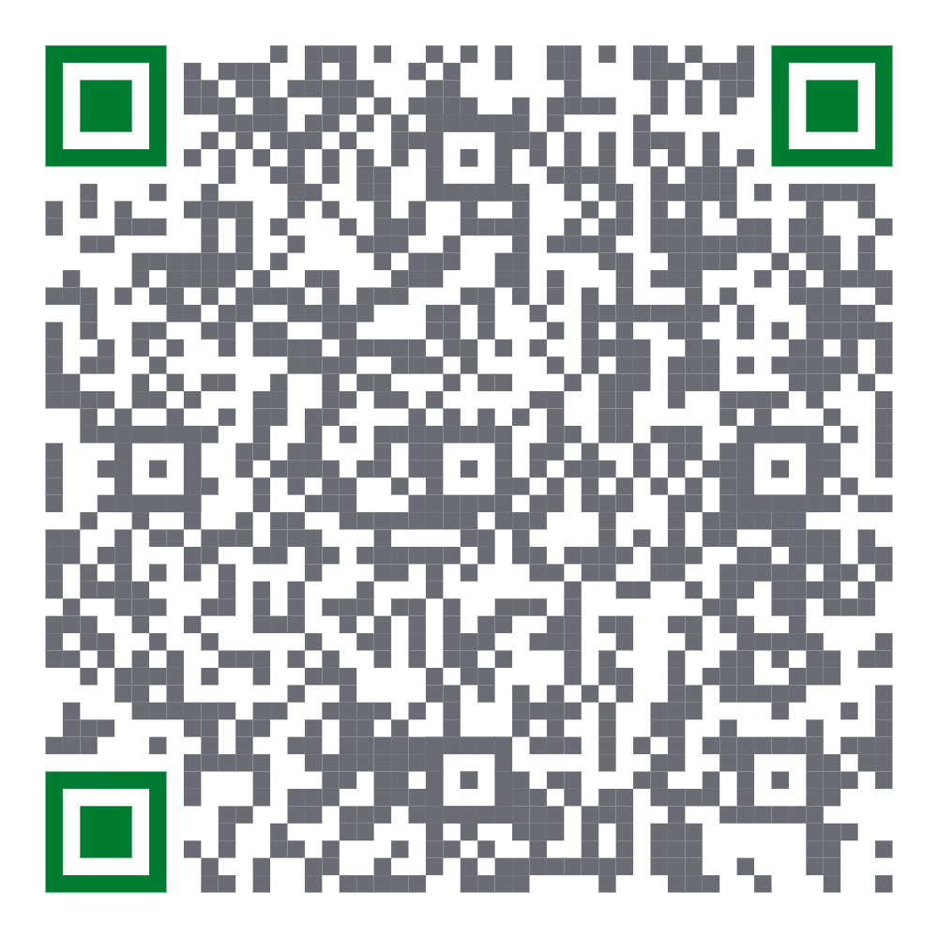
eLNs at Med Uni Graz (MUG)
At Med Uni Graz: eLabFTW
Following a workshop to find a suitable eLN variant, the roughly one-year test phase for eLabFTW was launched with kickoff meetings in November 2023. It culminated in a Lime Survey, accessible to active users from research over the summer months of 2024, which revealed the users' general satisfaction with eLabFTW and points where services and tool features could still be improved.
The implementation of those aspects was subsequently initiated.
From the very beginning, eLabFTW runs on a MUG server (elab.medunigraz.at) as productive system. Access to the respective teams can be granted by their admins and for the creation of new teams and questions, the RDM team is at your disposal (rdmsupport@medunigraz.at).
eLabFTW – for the world, for the wizards, …
The acronym FTW is actually meant for your own imagination.
eLabFTW ...
… is a web application licensed under the GNU Affero General Public Licence and is therefore free of charge.
… is backed by a whole community, continuously improving it, headed by eLabFTW creator Nicolas Carpi: https://github.com/elabftw/elabftw/issues
… is an object-based database. Instead of being structured hierarchical, each object stands for itself and can be placed in relation to other objects by using categories and tags. Additionally, links can be set between objects of any type or grouping.
Offers at Med Uni Graz
… regarding eLabFTW:
Training for new Users & Admins
Guides (Quickstart-, User- & Admin-)
Information on the off-boarding process
eLab User Jour fixe
Workshops
This and more can be found in the section “Elektronisches Laborbuch” of the IT-Knowledge Base - the QR code is shown below (only available within the MUG network):
Official Tutorials for eLabFTW
9 short introduction videos, 26 min total: Search on YouTube: eLabFTW [v.5.0] Tutorial - Nicolas CARPi
New features of the latest version, 8 min: Search on YouTube: eLabFTW [v.5.1] Release-Video - Nicolas CARPi
Find eLNs in IT-Knowledge Base:
Gudrun Kainz, RDM Team of Med Uni Graz
https://view.genially.com/66e1821238cb1b12e501b36b/interactive-content-rdm-team-service-flyer
rdmsupport@medunigraz.at
2024, DOI: 10.25365/phaidra.601_02
https://creativecommons.org/publicdomain/mark/1.0/deed
This licence does not include project and institute
logos, and individually referenced materials!

