Slide 1

European Open Science Cloud getting real: policies to launch EOSC and its governance structure
EOSC. Austria takes initiative
Vienna
30-10-2018
Jean-Claude Burgelman, Head of Unit
M. Schouppe, A. Karalopoulos,, M. Adojaan, C. Pascu, K. Szkuta, R. Keesenberg, E. Barbarossa
European Commission, Directorate General Research & Innovation (DG RTD)
Unit B2 – Open Science

Slide 2
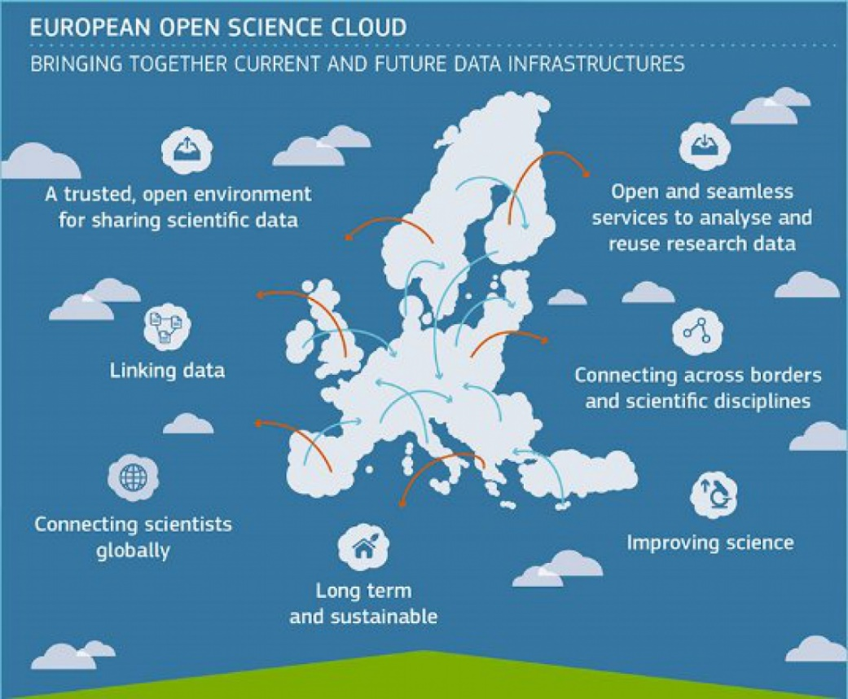
  The vision
“Europe's final transition must be one from fragmented data sets to an integrated European Open Science Cloud. By 2020, we want all European researchers to be able to deposit, access and analyse European scientific data through a European Open Science Cloud..”
Speech by Commissioner Carlos Moedas in Amsterdam, NL:
“Open science: share and succeed”, 4 April 2016
EOSC will provide 1.7m EU researchers an environment with free, open services for data storage, management, analysis and re-use across disciplines
EOSC will join existing and emerging horizontal and thematic data infrastructures, bridging todays fragmentation and ad-hoc solutions
EOSC will add value (scale, data-driven science, inter-disciplinarity, faster innovation) and leverage past infrastructure investment (10b per year by MS, two decades EU investment)

Slide 3
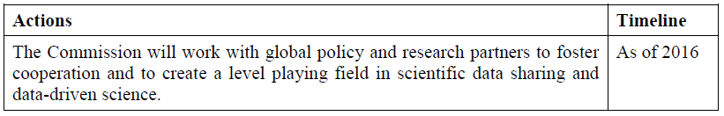
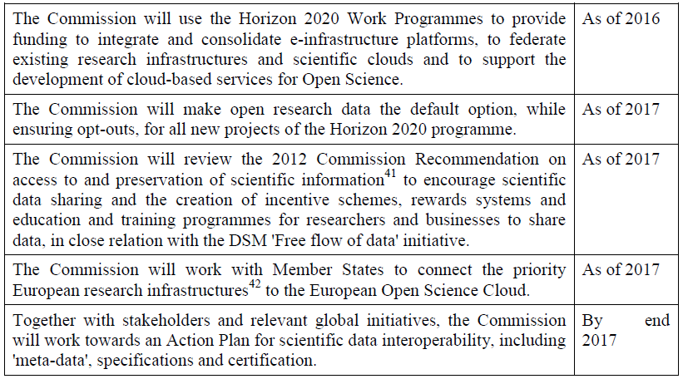
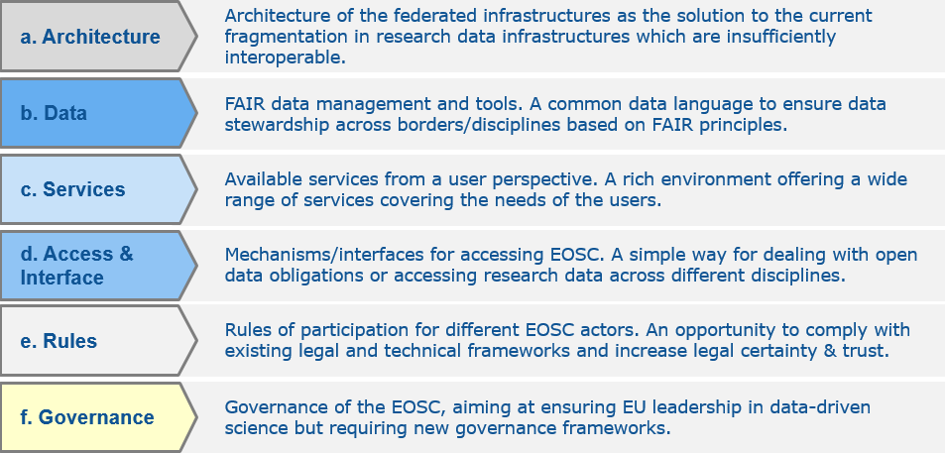
  History of the EOSC file
European
Cloud initiative
Implementation Roadmap
Council conclusions
H2020 – WP 2018-20
OECD,
RDA, G7
2016
Vision for European Open Science Cloud
WP2018-20
1 JAN 2017
Data
package
April 2018
INFRAEOSC-05-2018-2019 Call
2017
WP2018-20
FAIR
Action Plan
Federated model with 6 action lines
2018
Set up of EOSC governance framework by end 2018

Slide 4
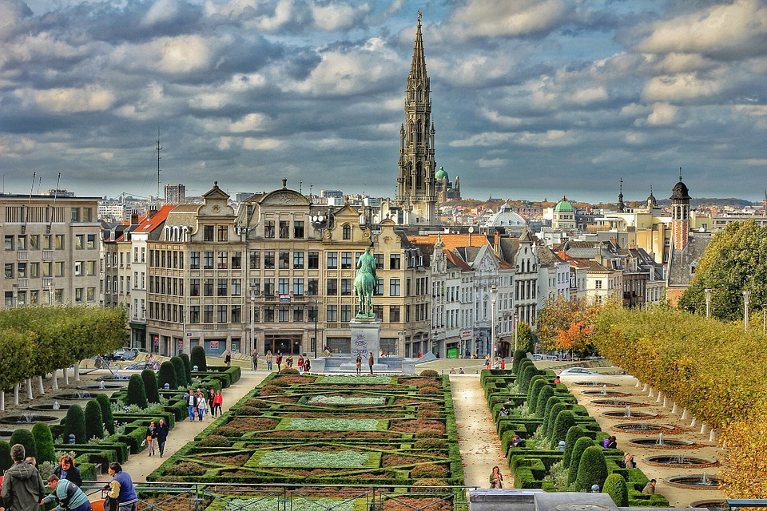
  Not a cloud made in Brussels

Slide 5
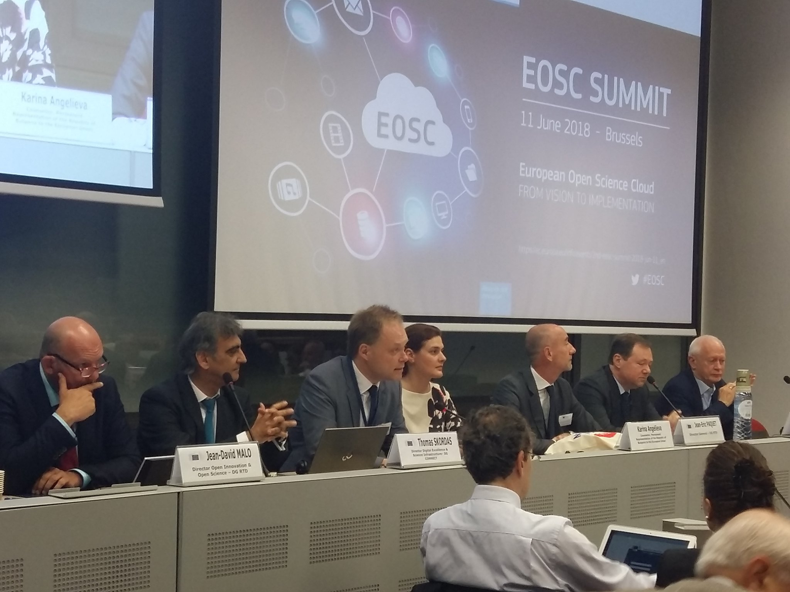
  EOSC Summit 2017 & 2018
180 key participants, representing all categories and scientific fields
15 research funders and 30 officials from Member States and Associated Countries
1000+ viewers via web stream
Extensive coverage via Twitter in the EU, USA and Canada (tweets and retweets reached 350k+ people)

Slide 6
  EOSC Declaration – 26 Oct 2017
33 high level statements meant to capture our common understanding on the required & underpin the EOSC implementation
  Data culture & FAIR data,
  Research data services & architecture,
  Governance and funding
Signed by more than 70 scientific stakeholders (so called 'Coalition of the Doers').
An Action List is attached.
DG RTD

Slide 7
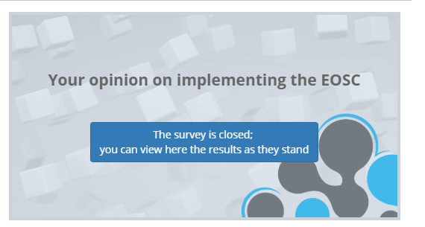
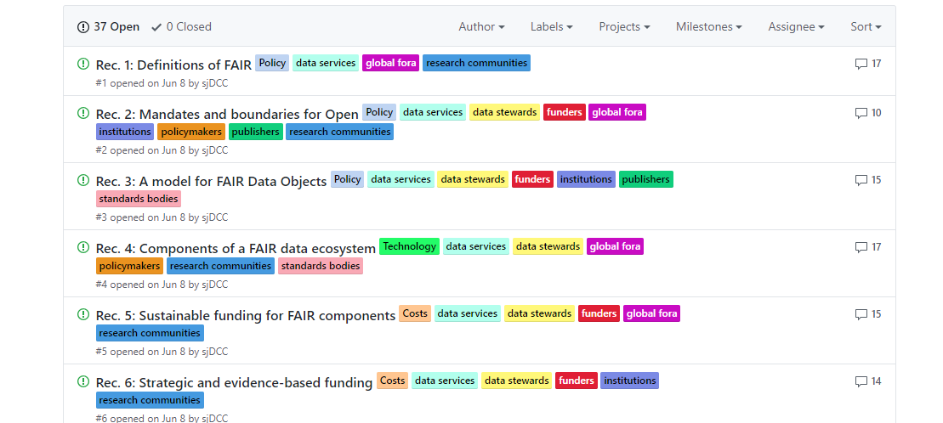
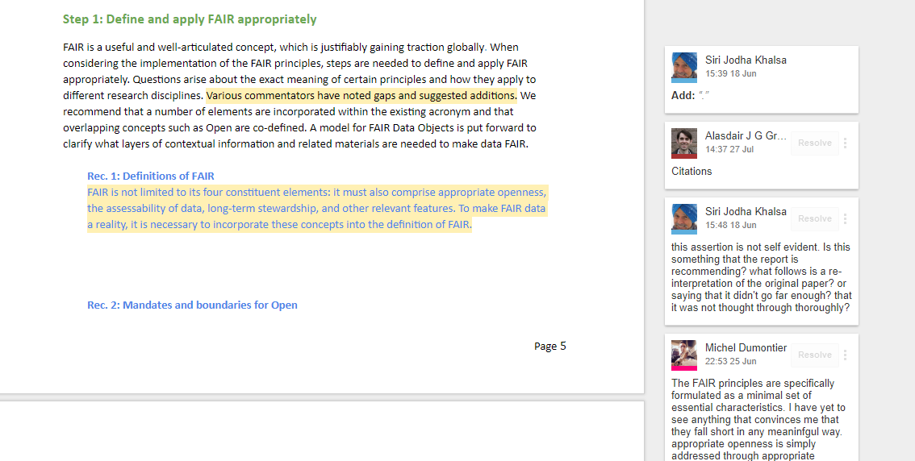
  Public consultations
  EOSC Rules of Participation
  FAIR data action plan
Rules of Participation recommendations: https://eoscpilot.eu/open-consultation
Turning FAIR into reality: http://bit.ly/interim_FAIR_report
FAIR Data Action Plan: https://github.com/FAIR-Data-EG/Action-Plan

Slide 8
  EOSC model / Governance
6 lines of action *
a. Architecture
Architecture of the federated infrastructures as the solution to the current fragmentation in research data infrastructures which are insufficiently interoperable.
b. Data
FAIR data management and tools. A common data language to ensure data stewardship across borders/disciplines based on FAIR principles.
c. Services
Available services from a user perspective. A rich environment offering a wide range of services covering the needs of the users.
d. Access & Interface
Mechanisms/interfaces for accessing EOSC. A simple way for dealing with open data obligations or accessing research data across different disciplines.
e. Rules
Rules of participation for different EOSC actors. An opportunity to comply with existing legal and technical frameworks and increase legal certainty & trust.
f. Governance
Governance of the EOSC, aiming at ensuring EU leadership in data-driven science but requiring new governance frameworks.
* Implementation Roadmap for the European Open Science Cloud (SWD(2018)83)

Slide 9
  Governance framework
SCOPE
  All actions needed for steering and overseeing the initial development of the EOSC (until end 2020) towards the EOSC federated model described in the EOSC Implementation Roadmap
EXPECTED DELIVERABLES
  Strategic plan, Annual work plans, FAIR action plan, Rules of participation, mechanism for post-2020 governance, approach to extend user base to industry and public authorities
ACTORS
  The governance should rely on the interplay between three components:
  EOSC Board
  EOSC Executive Board
  Stakeholders Forum

Slide 10
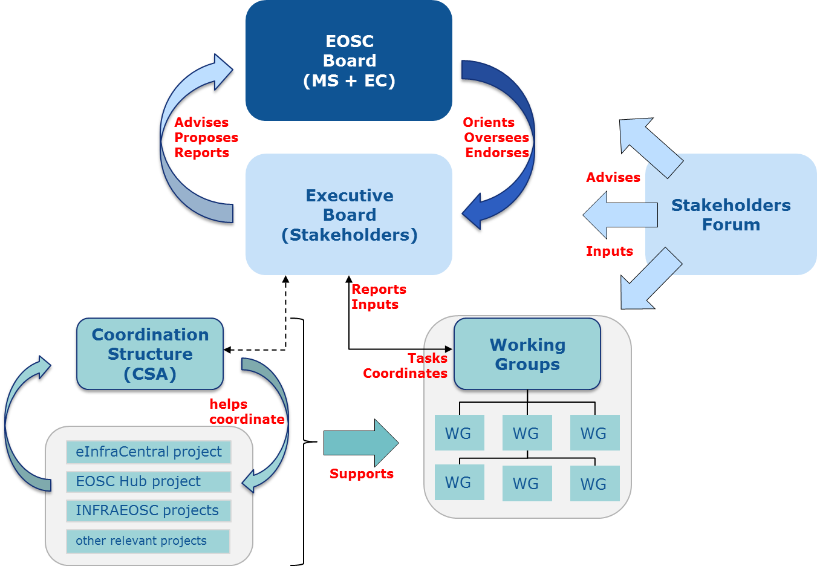
  Governance framework
Three layer structure as per Horizon 2020 WP 2018-2020
  EOSC Board of MS/AC and EC representatives to ensure effective supervision of EOSC implementation
  Executive Board of stakeholder representatives to help ensure proper EOSC implementation and accountability
  Stakeholder Forum to provide input from a wide range of actors
Further orientations for the set-up and composition of the Governance framework, to inform the consultation of MS without prejudging possible future decisions by the Council and the Commission

Slide 11
  Roles
  EOSC governance
 | Membership | Role
EOSC Board | Member States/Associated Countries and EC representatives | To oversee & steer the EOSC strategy and implementation → Review and decide
EOSC Executive Board | Stakeholder representatives and individual experts | To help & support the EOSC strategy, implementation, monitoring and reporting on progress of implementation → Elaborate and propose
Stakeholders Forum | Stakeholders organisations; e.g. scientific/user community, universities, research institutions, research infrastructures, eInfras | To advise the Executive Board and reach-out to the scientific community → Provide input and feedback

Slide 12
  Formal vehicles
  EOSC governance
 | Membership | Formal vehicle
EOSC Board | Member States/Associated Countries and EC representatives | Working Group of the strategic configuration of the H2020 PC (EOSC PC-WG)
EOSC Executive Board | Stakeholder representatives and individual experts | Commission formal Expert Group
Stakeholders Forum | Stakeholders organisations; e.g. scientific/user community, universities, research institutions, research infrastructures, eInfras | Self-organised with EC support; notably by the Coordination and Support Action funded by the WP of H2020 - INFRAEOSC Call

Slide 13
  Calendar
  EOSC governance
 | Formal vehicle | Set-up calendar
EOSC Board | Working Group of the strategic configuration of the H2020 PC (EOSC WG) | Set-up: October 2018 1st report to H2020 PC: 22/11 End: December 2020
EOSC Executive Board | Commission formal Expert Group | EC Decision: 27/08 Call for EoI: 11/9-10/10 Set-up: November 2018 End: December 2020
Stakeholders Forum | Self-organised with EC support; notably by the Coordination and Support Action funded by the WP of H2020 - INFRAEOSC Call | Currently: EOSC pilot Re-launch: early 2019

Slide 14
  EOSC Working Group
  EOSC governance
TASK
  To deliberate on the orientations of the actions funded under Horizon 2020 in support of the implementation of the EOSC
  To inform the related exchanges of views in the strategic configuration in the context e.g. of possible work programme updates in those fields
ACTIONS
  This will notably include:
  reviewing strategic implementation and annual work plans, and related documents submitted by the European Commission – notably coming from the EOSC Executive Board
  coordinating relevant national and Commission initiatives

Slide 15
  Next steps
  EOSC governance
20 September (PC meeting) | Decision to set up EOSC Working Group and agreement on terms of reference
end September | Invitation to Perm Reps to designate experts (deadline mid-October)
early November | MS designate representatives to the EOSC board. Selection of members to the governance structure.
mid November | Opinion of EOSC WG
22 November (PC meeting) | Approval by Strategic Configuration PC
23 November | Austrian Presidency event to launch the EOSC governance framework
We are here

Slide 16
  Financing of EOSC
Phase 1, until 2020:
  the Commission will invest EUR 300 million to support the core functions of the EOSC as per milestones
  Member States would flag the national initiatives that they want to federate into the EOSC (e.g. the work of the Helmholz Data Alliance); and the resources they are willing to provide in kind
  Research funders would start making costs eligible for FAIR data only
Phase 2, after 2020:
  To explore a mix of funding including possibly deposit fees from national funders
  Based on a full cost estimate for the running of the EOSC, conducted by the EOSC governance framework in Phase 1

Slide 17
  EOSC model / Data
6 lines of action *
a. Architecture
Architecture of the federated infrastructures as the solution to the current fragmentation in research data infrastructures which are insufficiently interoperable.
b. Data
FAIR data management and tools. A common data language to ensure data stewardship across borders/disciplines based on FAIR principles.
c. Services
Available services from a user perspective. A rich environment offering a wide range of services covering the needs of the users.
d. Access & Interface
Mechanisms/interfaces for accessing EOSC. A simple way for dealing with open data obligations or accessing research data across different disciplines.
e. Rules
Rules of participation for different EOSC actors. An opportunity to comply with existing legal and technical frameworks and increase legal certainty & trust.
f. Governance
Governance of the EOSC, aiming at ensuring EU leadership in data-driven science but requiring new governance frameworks.
* Implementation Roadmap for the European Open Science Cloud (SWD(2018)83)

Slide 18







  EC proposal for FAIR building blocks
EOSC Council Conclusions
Foster FAIR data
Make optimal use of existing initiatives
Implementation Roadmap
FAIR related actions, milestones and resources
EOSC
Declaration
Commitments to change towards FAIR
Data culture and skills
Rewards & incentives
Data tools and services
European Cloud Initiative
Make open research data the default option
FAIR DMPs
Policy context
Demonstrate the financial case
Cost of not having FAIR data
Cost-benefit analysis
Recommendations for sustainability
Support implementation
Turning FAIR data into reality
FAIR data action plan
2018
Policy implementation
Provide
guidance
European Research Interoperability Framework
Maximize efficiencies
Annual FAIR data Work Plan
Ensure governance
- FAIR data Working Group
2019
Target groups
Measure readiness
Core assessment criteria
FAIR data maturity model
Promote certification
Accreditation / certification scheme
Policy makers
2020
Funders
Researchers
Infrastructures
Coordination Fora

Slide 19



  Demonstrate the financial case
  FAIR@EC in 2018
Evidence
Methodology
FAIR data Working Group
Cost of not having FAIR data
Business models
Estimations
Input
Cost-benefit
analysis
Annual FAIR data Work Plan
Recommendations
for
sustainability
FAIR data maturity model

Slide 20


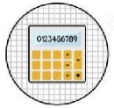












  Support implementation
  FAIR@EC in 2018
Concepts and context
Common layer for extensions and specializations
Research data culture
Technical ecosystem
Turning FAIR data into reality
Skills
Input
Incentives and rewards
FAIR data
Working Group
Core assessment criteria
FAIR data action plan
Metrics
Annual FAIR data Work Plan
FAIR data maturity model
European Research Interoperability Framework
Accreditation / Certification scheme
H2020-INFRAEOSC

Slide 21

Thank you for your attention
Team leader: Michel SCHOUPPE
Maarja ADOJAAN
Emanuele BARBAROSSA
Athanasios KARALOPOULOS
Roy KEESENBERG
Corina PASCU
Konstantinos REPANAS
Katarzyna SZKUTA
Website: http://ec.europa.eu/research/openscience/eosc
E-mail: EOSC-RTD@ec.europa.eu
Notes:
21

