Slide 1
The European Open Science Cloud - What does it implicate for Austria?
Stefan Hanslik
Technical Science
Vienna, 30th.Oktober 2018

Slide 2
The European Open Science Cloud
The 2018 EOSC Summit (held on 11 June 2018) called for acceleration towards making the European Open Science Cloud a reality, hinting at the need to further strengthening the ongoing dialogue across institutions and with stakeholders.

Slide 3
The European Open Science Cloud – A common European effort!
“The EOSC will allow for universal access to data and a new level playing field for EU researchers CERN, EMBL, ELIXIR, etc. Institutional repository Member State Infrastructure New provider/ service…”
Communication from the Commission to the European Parlament, the Council, the European Economic and Social Committee of the Regions- European Cloud Initiative - Building a competitive data and knowledge economy in Europe, COM(2016) 178 final
H2020 Programme Guidelines on FAIR Data Management in Horizon 2020 Version 3.0. 26 July 2016
EOSC Declaration Brussels, 10 July 2017
Commission Staff Working Document, Implementation Roadmap for the European Open Science Cloud, Brussels, 14.3.2018, SWD(2018) 83 final
Council Conclusion EOSC, Brussels 29. Mai 2018, 9291/18
Commission Decision of 27.8.2018, Setting up an Expert Group- Executive Board of EOSC
Stefan Hanslik
Technical Science
Vienna, 30th.Oktober 2018

Slide 4
The European Open Science Cloud
EOSC is the result of various initiatives of the European Commission, started in2015 with the adoption of the Digital Single Markets strategy (http://ec.europa.eu/priorities/digital-singe-market_en)
Research data: EOSC aims to create a trusted environment for hosting and processing research data to support EU science in its global leading role.
The EOSC implementation is supposed to continuously evolve with active participation of researchers, infrastructures and funding bodies.

Slide 5
EOSC-Advance Europe together!
“Austrian Open Science Cloud- as part of EOSC”
Austrian Open Science Support Group (AOSSG)
Research Infrastructures and huge Austrian transversal projects
AOSSG was founded at the University of Vienna in 2016, and among other it produced a) the „USE CASE AUSTRIA“ (participation to series of event and conferences, illustrating the research infrastructures in Austria), b) AOSSG produced an „Austria Country Profile“, and c) worked as incubator fort he creation of IOSSG (Italian Open Science Support Group/ Members: Unversities of Bologna, Parma, Milano, Ca’Foscari Venezia, Politecnico Torino, Trento)
TU Wien
TU Graz
Know-Center Graz
Academy of Fine Arts Vienna
ACONet (Austrian Academic Computer Network)
AUSSDA - The Austrian Social Science Data Archive
Climate Change Center Austria (CCCA)
Earth Observation Data Center (EODC)
IST Austria
Know-Center Graz
Open Knowledge Maps
TU Wien
University of Graz
University of Innsbruck
University of Salzburg
University of Vienna
Vorarlberger Landesbibliothek
ZAMG
Research Data Alliance Austria
In November 2017 the workshop From Planning to Action. Towards the Establishment of an Austrian Research Infrastructure took place, jointly organized by TU Wien and the University of Vienna in cooperation with RDA Europe. It was the first workshop in Austria in a series of European-wide RDA events in preparation for the establishment of more formal RDA structures in Austria. The documentation can be found at http://phaidra.univie.ac.at/o:584416.
e-Infrastructures Austria and e-Infrastructures Austria Plus
Open Education Austria
Austrian Transition to Open Access (AT2OA)
Data Market Austria
Portfolio Showroom
BBMRI
FAIR principles
Major issue: the implementation of the FAIR principles and the improvement of the related services in Austria by implementation of a FAIR node.

Slide 6
The Infrastructure layer
The Governance layer (Governmental and legal Framework)
APPLICABLE LEGAL FRAMEWORKS (e.g. GDPR, copyright rules, Data Security and Cybercrime,
dispute resolution and redress mechanisms, e-commerce directive)
LEGAL PROVISIONS RELEVANT TO THE TOPICS OF OPEN ACCESS TO
PUBLICATIONS AND OF RESEARCH DATA MANAGEMENT, SHARING AND REUSE
NATIONAL AND REGIONAL POLICIES AND GUIDELINES RELATED TO OPEN
SCIENCE
RESEARCH DATA RELATED POLICIES AND REQUIREMENTS
Ministries responsible: Austrian Ministry for Education, Science and Research; Transport, Innovation and Technology as well as Digital and Economic affaires.
FAIR principles
The Service layer
Services to find, access, store, re-use and analyse
Access to relevant information (e.g. status of EOSC, list of infrastructures,
policy-related information, compliance framework)
OPEN SCIENCE RELATED INFRASTRUCTURE
MEMBERSHIPS (ESFRI, NATIONAL RESEARCH INFRASTRUCTURES, LIBRARIES etc…)

Slide 7
Complementary (Infra-) Structures:
Cross-disciplinary
Austrian State Archives | Data centre | http://www.oesta.gv.at/
BRZ - Austrian Federal Computing Center | Data centre | https://en.brz.gv.at/
IIASA – International Institute for Applied Systems Analysis | Repository | http://pure.iiasa.ac.at/
JKU ePub (University Library Linz) | Repository | http://epub.jku.at/
Phaidra - Permanent Hosting, Archiving and Indexing of Digital Resources and Assets (Univ. of Vienna) | Repository | https://phaidra.univie.ac.at/
reposiTUm (TU Wien) | Repository | http://repositum.tuwien.ac.at/
Volare | Repository | https://pid.volare.vorarlberg.at/
IST PubRep (Institute of Science and Technology) | Repository | https://repository.ist.ac.at/
Physical Sciences & Engineering
Architektur-Informatik | Repository | http://architektur-informatik.scix.net/
CCCA - Climate Change Center Austria | Data centre | https://www.ccca.ac.at/
EODC - Earth Observation Data Centre | Data centre | https://www.eodc.eu/
Life Sciences
BBMRI ERIC | Data centre | http://www.bbmri-eric.eu/
LBI-HTA – Ludwig Boltzmann Institute of Health Technology Assessment | Repository | http://eprints.hta.lbg.ac.at/
Social Sciences & Humanities
Institutional Repository of the University of Applied Arts | Repository | https://phaidra.bibliothek.uni-ak.ac.at/
AUSSDA – Austrian Social Science Data Archive | Data Centre | https://aussda.at/en/
ePUBWU (Vienna University of Economics and Business) | Repository | http://epub.wu.ac.at/

Slide 8
a stronger connectivity between research-infrastructures
What will it bring ?
Significant added value for all participating scientists, researchers and infrastructures
Stefan Hanslik
Technical Science
Vienna, 30th.Oktober 2018

Slide 9
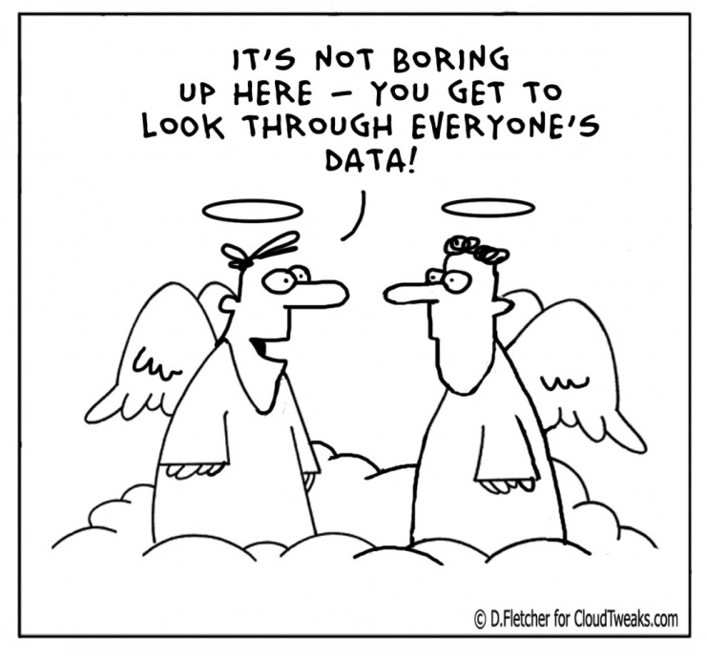
Search
Websites
Staff search
Search
Quick links
Home
Programme
Venue
Travel
Conference in Vienna, 30th October 2018 The European Open Science Cloud: Austria takes initiative
Conference in Vienna, 30th October 2018 The European Open Science Cloud: Austria takes initiative
You are here:
Conference in Vienna, 30th October 2018 | The European Open Science Cloud: | Austria takes initiative
Home
The European Open Science Cloud (EOSC)
The idea of a European Open Science Cloud (EOSC) emerged in 2015 as the European Commission’s vision of an integrated transnational research infrastructure to support and promote open science and innovation in Europe and beyond. The EOSC federates existing scientific data systems to offer science and technology professionals unprecedented access to storage, management, analysis, and re-use of research data and services that have been historically confined within geographic borders or scientific disciplines. The EOSC envisions establishing a European data infrastructure, integrating high-capacity cloud solutions, eventually widening the scope of these services to include the public sector and industry.
Several important EOSC milestones will occur during the Austrian EU presidency in the second half of 2018. One of these events will be a conference showcasing European and Austrian organizations, infrastructure projects, and data initiatives—the material foundations on which the EOSC infrastructures will be built—that embody the EOSC themes of Governance & Funding, Data Culture and FAIR Data, and Services and Architecture.
The Conference
The Presidency event "The European Open Science Cloud: Austria takes initiative" will be held on 30 October 2018 at the University of Vienna. It will be a full-day event, covering all aspects of existing national and regional EOSC-ready programs. The session will be concluded with a panel discussion on how the EOSC can be implemented effectively at the Member State level. The conference will take place at the University of Vienna and is organized in collaboration with a team of senior experts of the Library and Archive Services of the University of Vienna, the Vienna University Computer Center, the Center for Research Data Management of TU Wien, the Austrian Federal Ministry of Education, Science and Research - BMBWF/ unit responsible for technical science and the European Commission.
Organizers
Austrian Federal Ministry of Education, Science and Research (BMBWF), University of Vienna, TU Wien, European Commission
Contact
The European Open Science Cloud: Austria takes initiative Universitätsring 1 A-1010 Vienna T: +43-1-4277-17677 eosc18@univie.ac.at
Organizers
Austrian Federal Ministry of Education, Science and Research (BMBWF), University of Vienna, TU Wien, European Commission
What does it implicate for Austria?
Austrian activities can be seen as one Reference-Model
Establishment of Governance, Services and Data-Architecture are essential
Data culture is also seen as a key aspect
The service layer of EOSC is of high importance

Slide 10
November Event
This event is proposed under the title “EOSC – Launch of the EOSC Governance Structure”. Presentation of a Governance Structure to start the EOSC", and is scheduled for November2018,
Key aspect will be the governance layer of EOSC. Main subject will be a clear governance framework for the EOSC initiative that makes it predictable: a multi-level, multi-stakeholder governance with clear institutional, executive and advisory roles that empowers the scientific community and evolves with time.
Another aspect will be the services needed to enable the integration of and access to the data recources to be federated in the EOSC.

Slide 11
Thank you for your attention and coming to Vienna!
Stefan Hanslik
Technical Science
Vienna, 30th.Oktober 2018

