Slide 1
Data Market Austria
Allan Hanbury (TU Wien)
Mihai Lupu (Research Studios Austria FG)

Slide 2
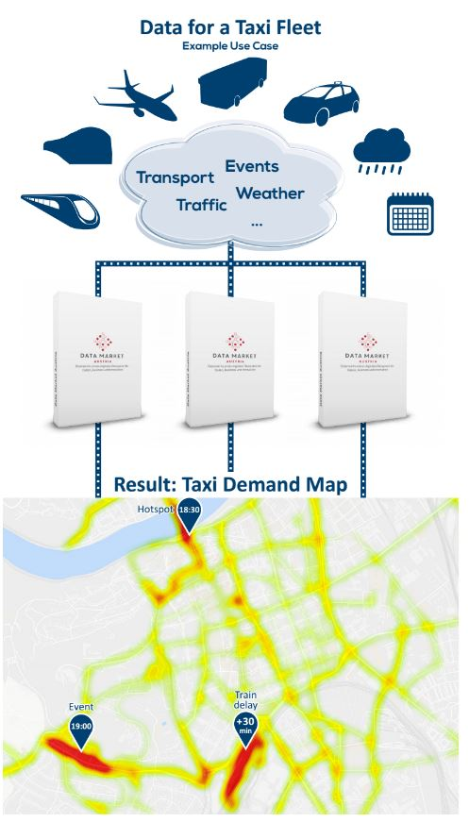

Slide 6
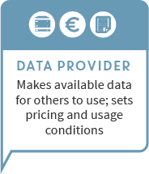
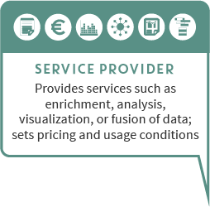
Offer
Service Providers
Data Providers
Infrastructure Providers

Slide 7
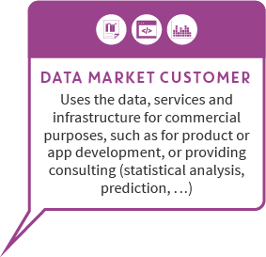
Demand
Data Market Customers

Slide 8
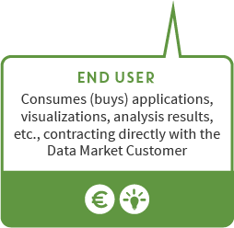
Demand
Data Market Customers
End Users

Slide 9
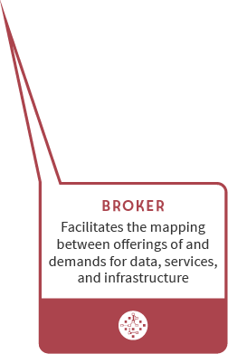
Brokerage
Brokers

Slide 10
Service Providers
Data Providers
Data Market Customers
Research and Development (Basic and Applied)
End Users
Brokers
Infrastructure Providers

Slide 11
timeline
Business Model Development
General requirements
Prototype
Final version
technology development
legal requirements
user workshops
technology integration
technology development
basic services
fully integrated
billing services integrated
general availability
Dec 2018
Nov 2018
Oct 2016
Oct 2017
Oct 2018
Oct 2019
First 6 company partners deploying on DMA
EBDVF in Vienna
ICT Imagine Digital in Vienna
Notes:
Business Models

Slide 12
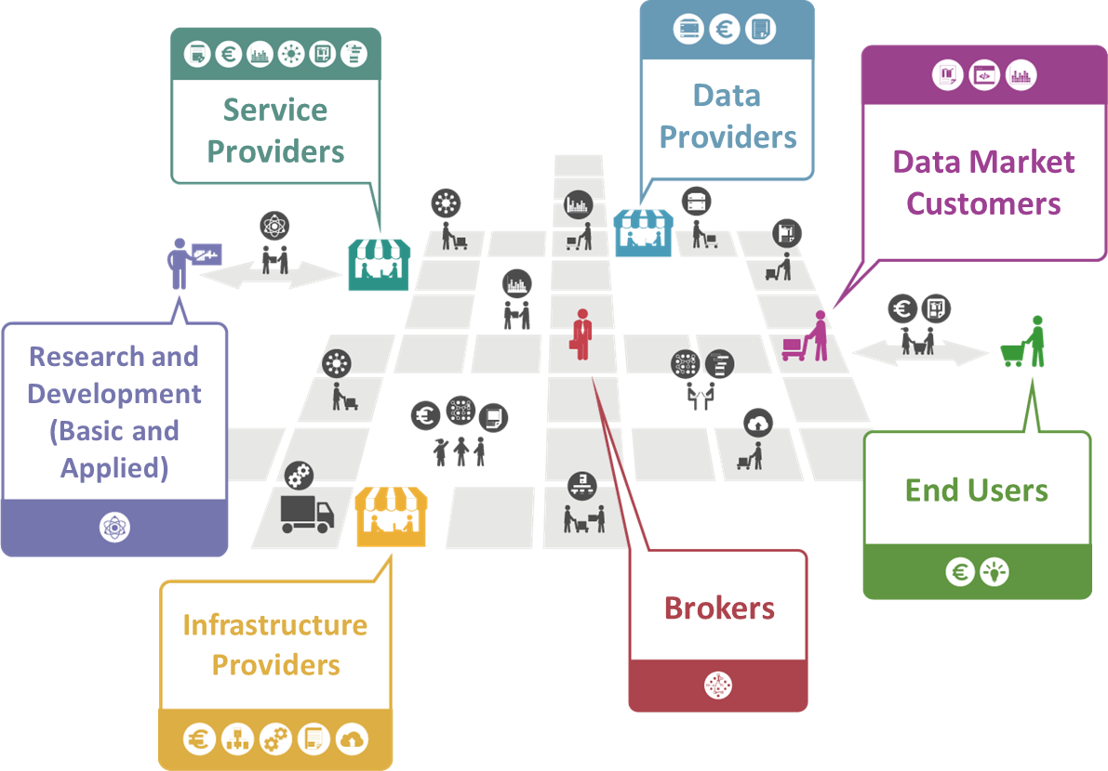
Market Complexity
http://datamarket.at
http://industrialdataspace.org
Notes:
Large number of SMEs in Austria
Austria as a good country to do innovative experiments

Slide 13
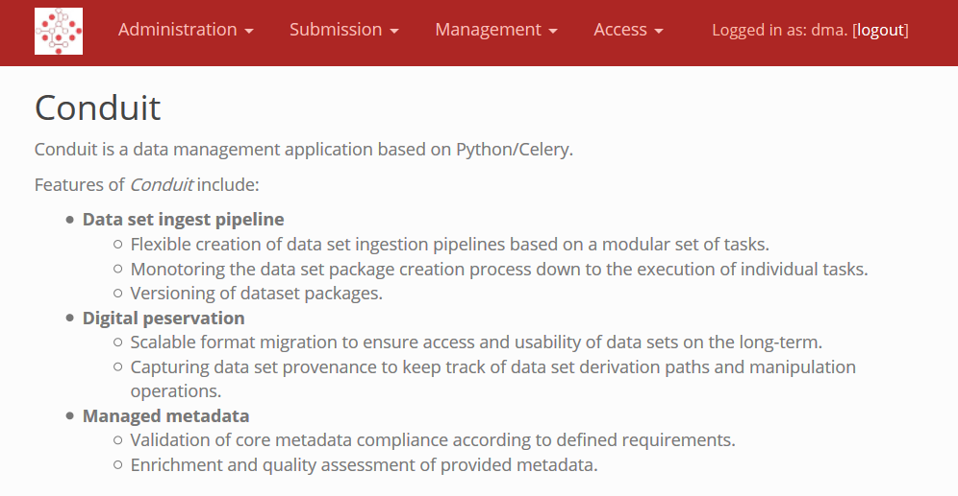
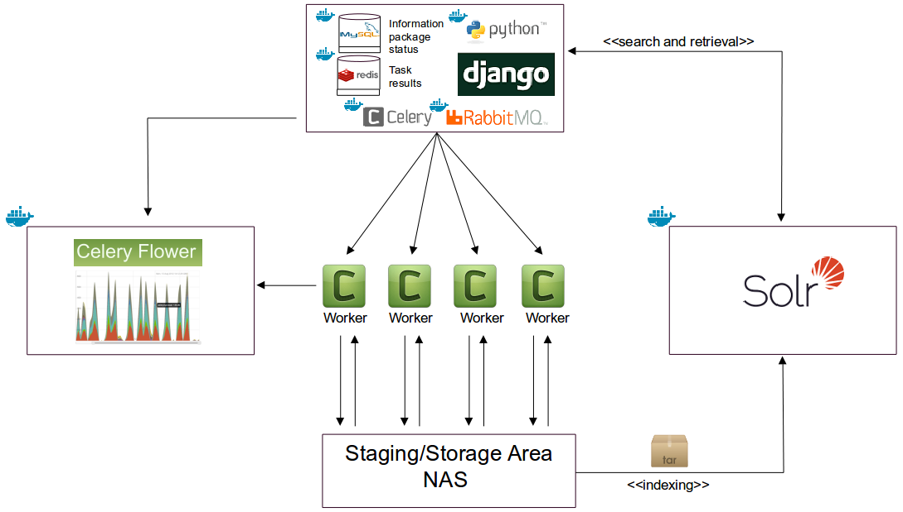
Data Management
Notes:
Tool for data provider node (data & metadata provisioning)
Ingest pipelines
Task execution monitoring
Versioning/data provenance
Metadata validation
Metadata enrichment
Quality assessment

Slide 14
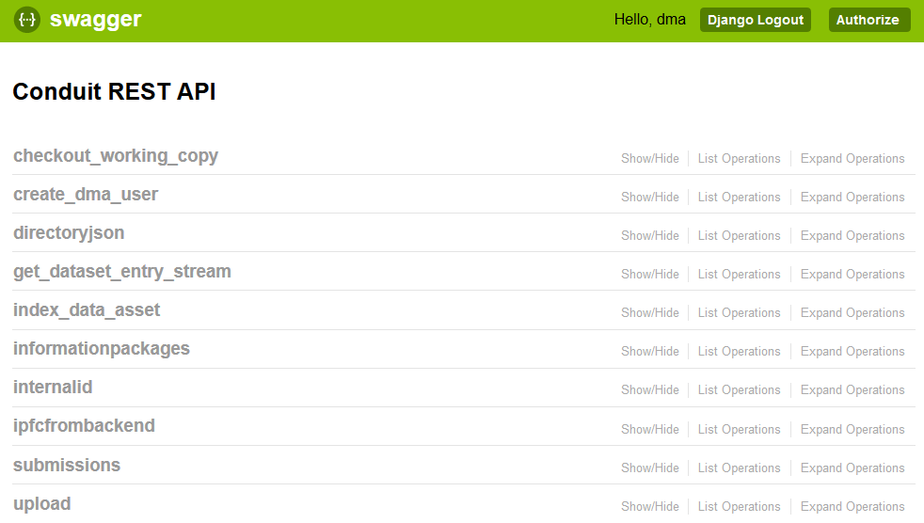
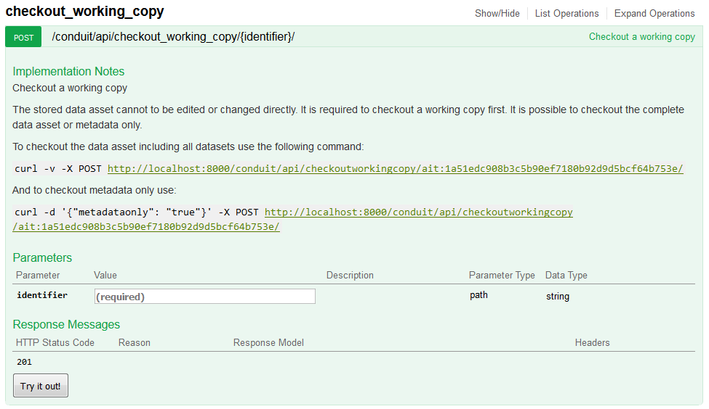
Data Management interfaces
ResourceSync Harvesting Interface

Slide 15
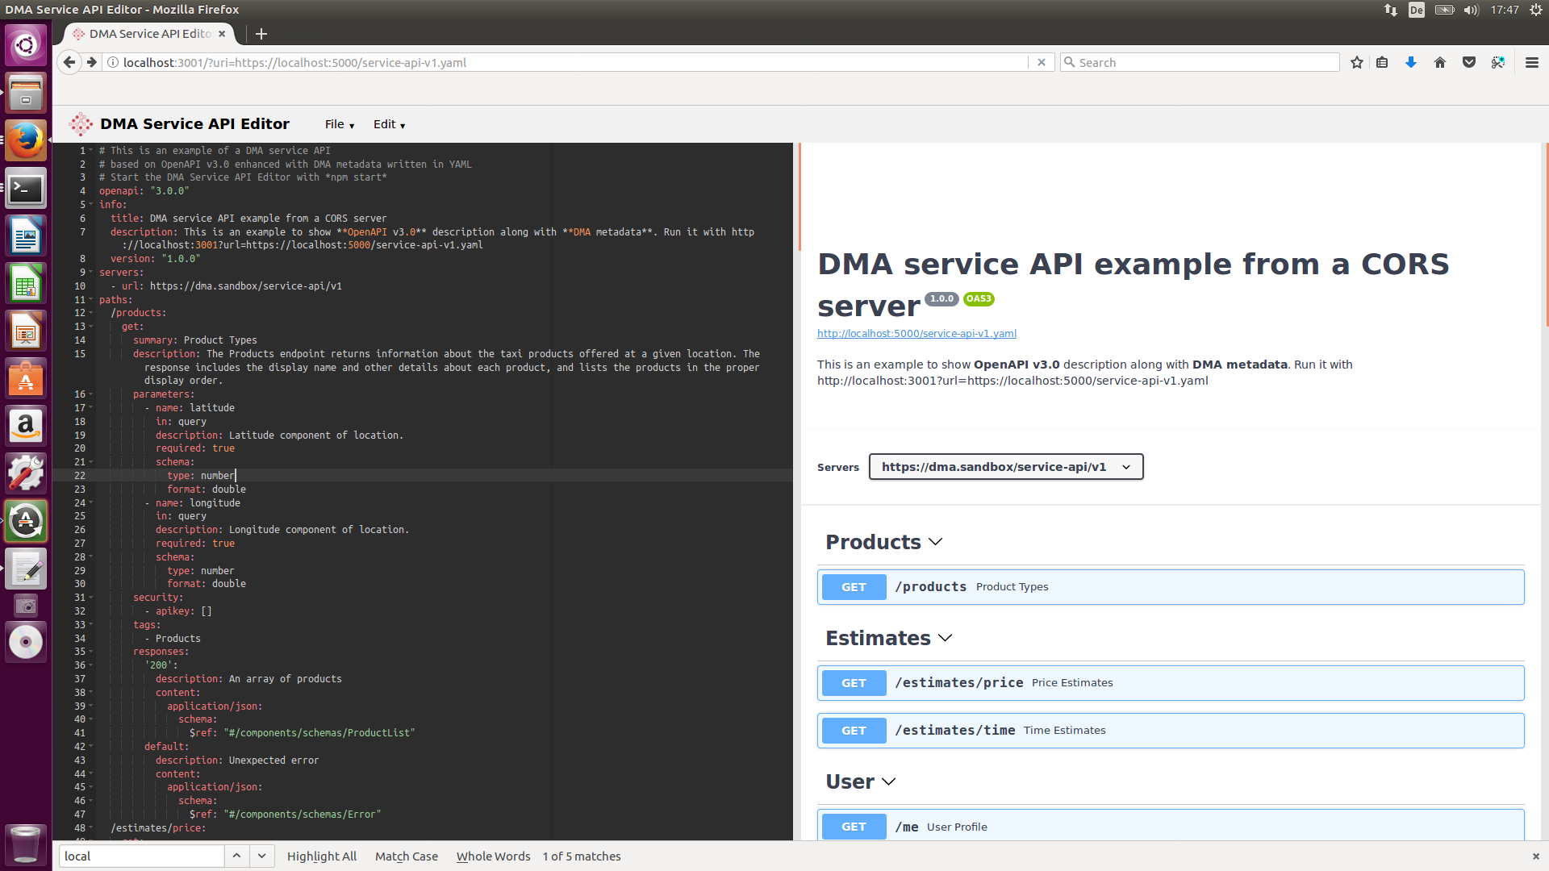
DMA Service API Editor I
API Editing
API Documentation

Slide 16
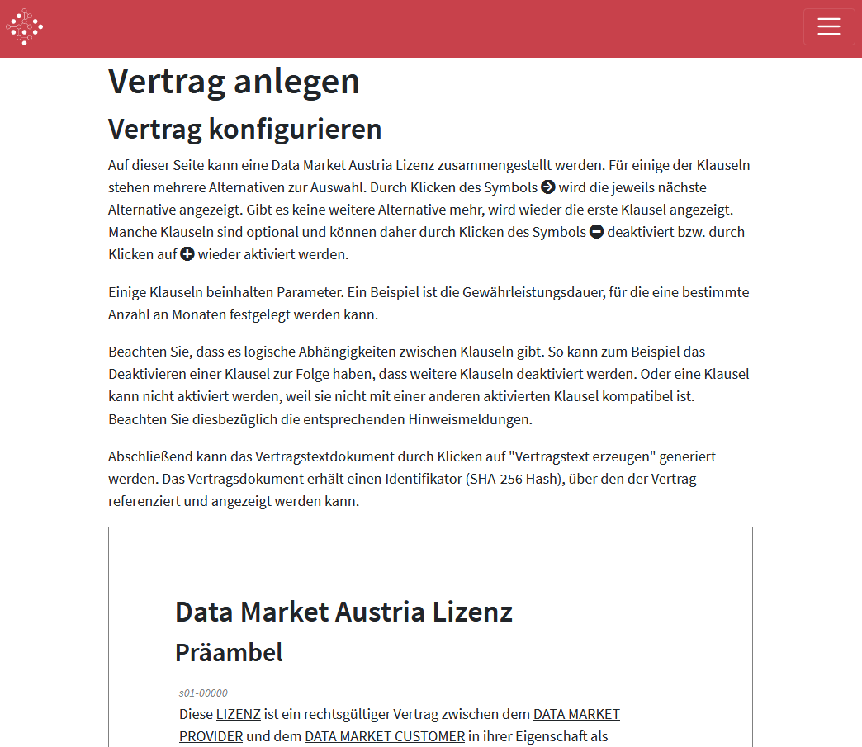
“DMA Data Model License” generation

Slide 17
Final Report on Legal, Social and Cultural Aspects

Slide 18
Forest (Change) Monitoring
Draft Result of Forest (Change) Monitoring
Forest Type Map (Coniferous. Broadleaf, Mixed Forest)
Change areas in RED
Input for service → „Updated Rockfall Propagation“

Slide 19
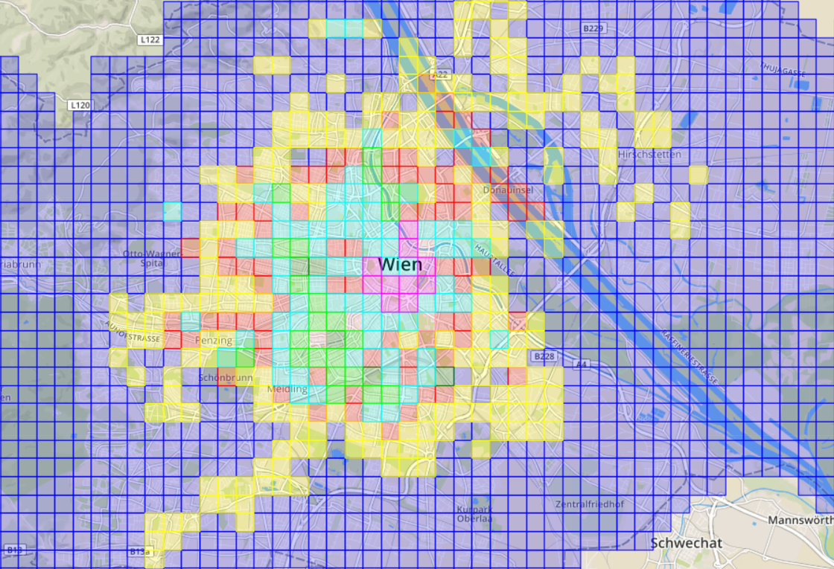
Detecting Practical Borders of Prediction Models Classifying T-Mobile Data: Absolute Clusters
Absolute clusters show the regions of similar number of people during a day
These clusters can help in energy forecasting to normalize the predicted values

Slide 21
Outlook
DMA could support data/service exchange between multiple types of stakeholders
DMA is built in a modular form – the modules can be reused for other platforms
The legal framework around data exchange is very well investigated
A2A
Administration
A2B
A2R
B2A
R2A
Business
R2B
Research
B2R
B2B
R2R

Slide 22
Visit us at the EBDVF 2018

Slide 23
Thank you!
Any questions?
@DataMarketAT
mihai.lupu@researchstudio.at
Dr. Mihai Lupu
DMA Coordinator
Studio Director | Research Studio Data Science Research Studios Austria Forschungsgesellschaft mbH www.researchstudio.at

