Slide 1
bbmri-eric
Erik steinfelder

Slide 2
Who
We are
BBMRI-ERIC is a research infrastructure of biobanks and biomolecular resources that provides expertise and services
in order to facilitate the use of European sample collections and data for the benefit of human health.

Slide 3
Where
We are
Members of
Bbmri-eric
Austria
Belgium
Bulgaria
Czech Republic
Estonia
Finland
France
Germany
Greece
Italy
Latvia
Malta
Netherlands
Norway
Poland
Sweden
United Kingdom
Observers of
Bbmri-eric
Switzerland
Cyprus
Turkey
IARC

Slide 4
#DigitalScience

Slide 5
The world‘s biggest
Biobank directory

Slide 6
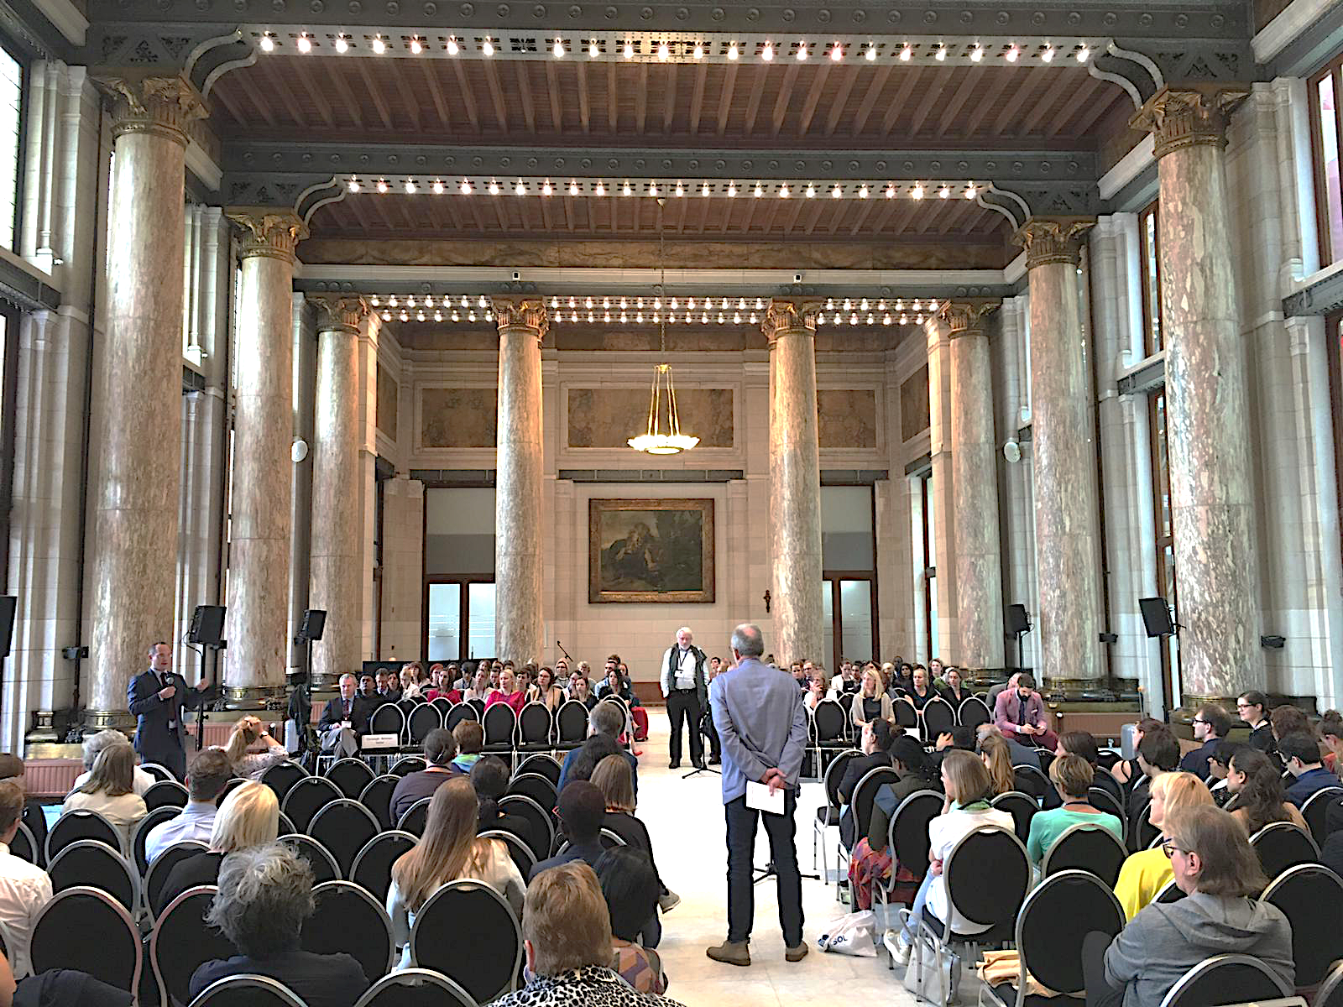
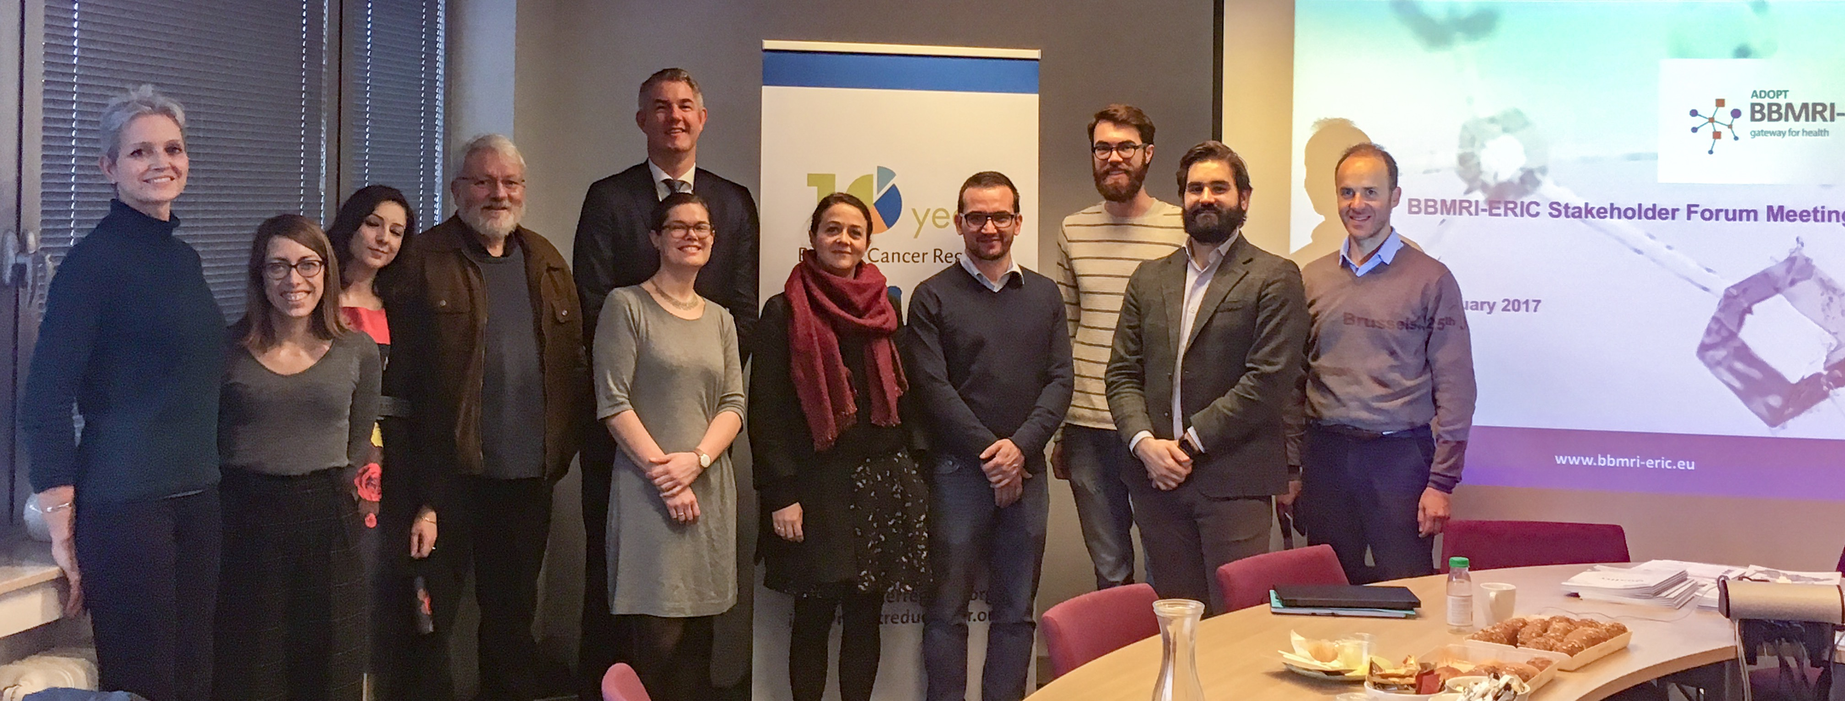
Increased role in BBMRI-ERIC
Involving patients & consumers in our work
January 2018 – face to face meeting in Brussels
New members invited
New strategic approach
September 2018 – meeting at EBW
From 1 to 7 patients/consumers present at EBW18
Increased involvement in sessions
1 chair
2 speakers (the debate on RRR)
Countless questions
Contribution to the Work Programme 2019

Slide 7
GDPR
Code of conduct for health research
To contribute to the proper application of the regulation, taking into account the speciﬁc features of processing personal data in the area of health;
To clarify and specify certain rules of the GDPR for controllers who process personal data for purposes of scientiﬁc research in the area of health
To help demonstrate compliance by controllers and processors with the regulation
To help foster transparency and trust in the use of personal data in the area of health research.

Slide 8
#EOSC-life - Thank you!
contact@bbmri-eric.eu
www.bbmri-eric.eu
@BBMRIERIC BBMRI-ERIC

