Slide 1
Data Culture & FAIR Data: AUSSDA – The Austrian Social Science Data Archive
Lars Kaczmirek
#AUSSDA @TheAUSSDA
Vienna, 30.10.2018
Presentation at “The European Open Science Cloud: Austria takes initiative”
Notes:
EOSC aims to make research data widely usable. With AUSSDA - The Austrian Social Science Data Archive exists an infrastructure facility, which makes social science data accessible and reusable, for science and society. The talk illuminates the practical implications for archiving and reuse of research data as part of Open Access, Open Data and Open Educational Resources and explains the role of national infrastructures in the EOSC.

Slide 2
Outline
How does the work of a national service provider fit in EOSC?
Data Culture: Our approaches to openness
FAIR Data: Turning principles into practice

Slide 3
“We make social science data accessible, creating opportunities for research and data reuse, benefitting science and society.“
Our mission

Slide 4
The EOSC federated model approach
Social Sciences
CESSDA ERIC
AUSSDA
Technical Implementations
Domain C
Domain B
Researcher
more…
Member State Infrastructure C
Member State Infrastructure A
more…
EOSC

Slide 5
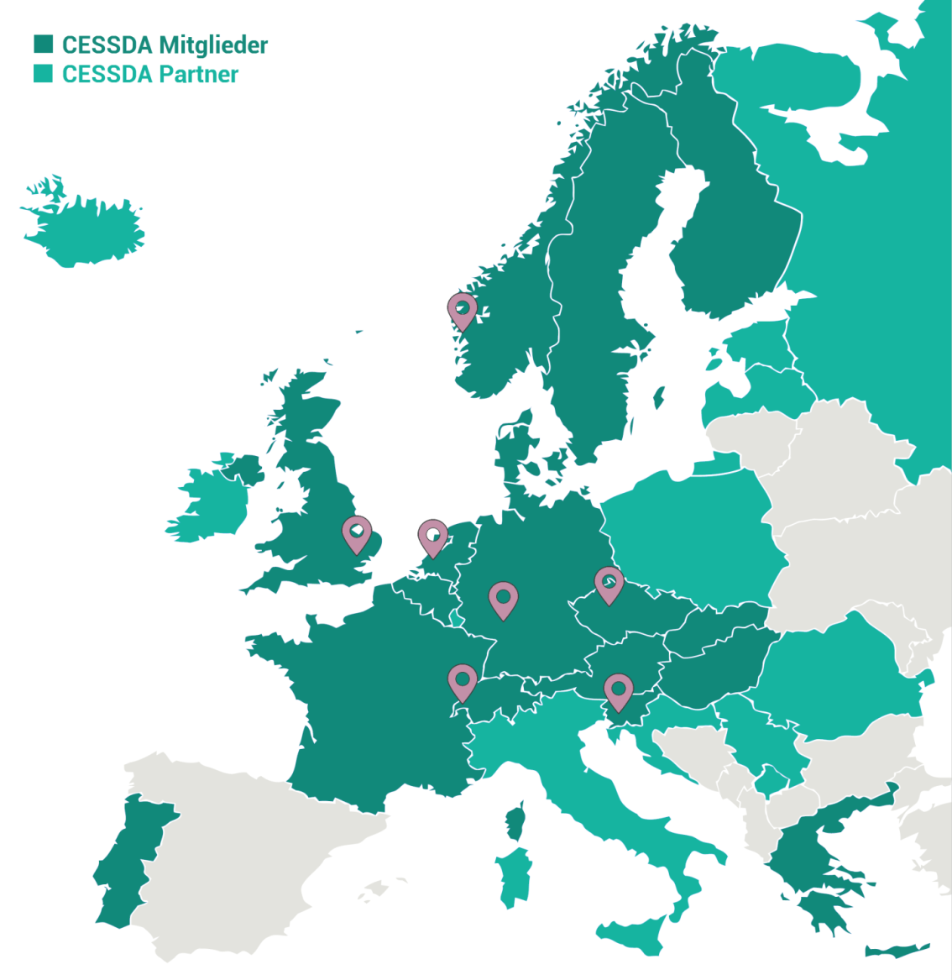
Governance: The Consortium of European Social Science Data Archives (CESSDA ERIC)
AUSSDA international advisory board
ADP in Slovenia
CSDA in the Czech Republic
DANS in the Netherlands
FORS in Switzerland
GESIS in Germany
NSD in Norway
UK Data Service
…
Notes:
Vernetzt mit verschiedenen nationalen Datenarchiven in Europa.

Slide 6
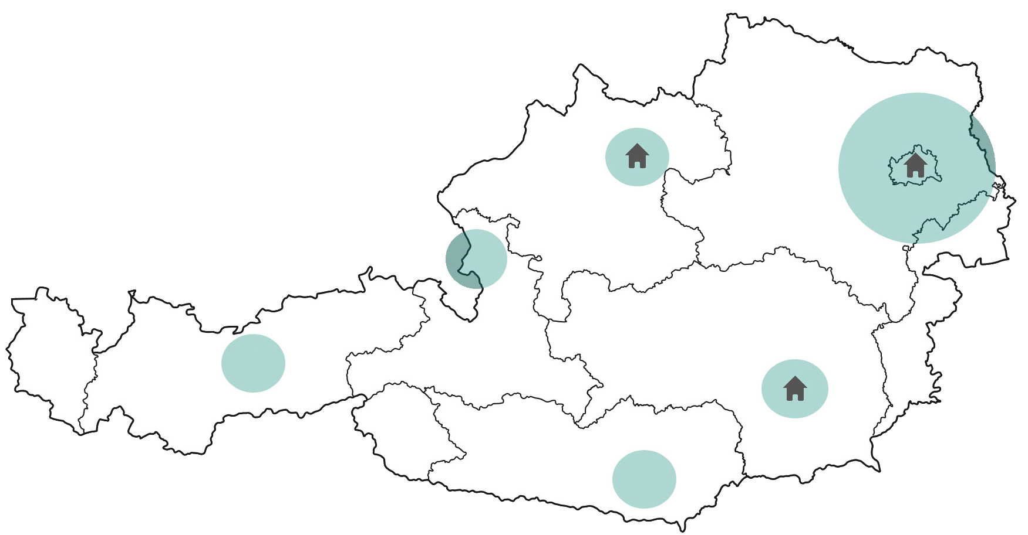
AUSSDA governance at the national level
Three locations - in Vienna, Linz and Graz
National board members from 14 institutions (incl. funding agencies)
Notes:
Wir haben den Anspruch, eine dezentrale Einrichtung zu sein, die für ganz Österreich und verschiedene Disziplinen in den Sozialwissenschaften ihre Services anbieten kann. Unser Headquarter ist in Wien, unsere Außenstellen in Linz und Graz. Um die Regionen darüber hinaus abzudecken, haben wir einen nationalen Beirat mit wichtigen Stakeholdern.

Slide 7
Service: CESSDA Data Catalogue
CESSDA Data Catalogue
collecting (harvesting) metadata
Member State
Service Provider A
more…
Member State
Service Provider C

Slide 8
Service: DataverseEU
CESSDA ERIC develops a cloud-based service to share and archive data.
Based on The Dataverse Project, Open source research data repository software, https://dataverse.org/
Investment to meet needs in Europe
Multi-language support
CESSDA ERIC metadata schema for the social sciences
Support for different types of persistent identifiers (PID, e.g., DOI via Datacite)
…

Slide 9
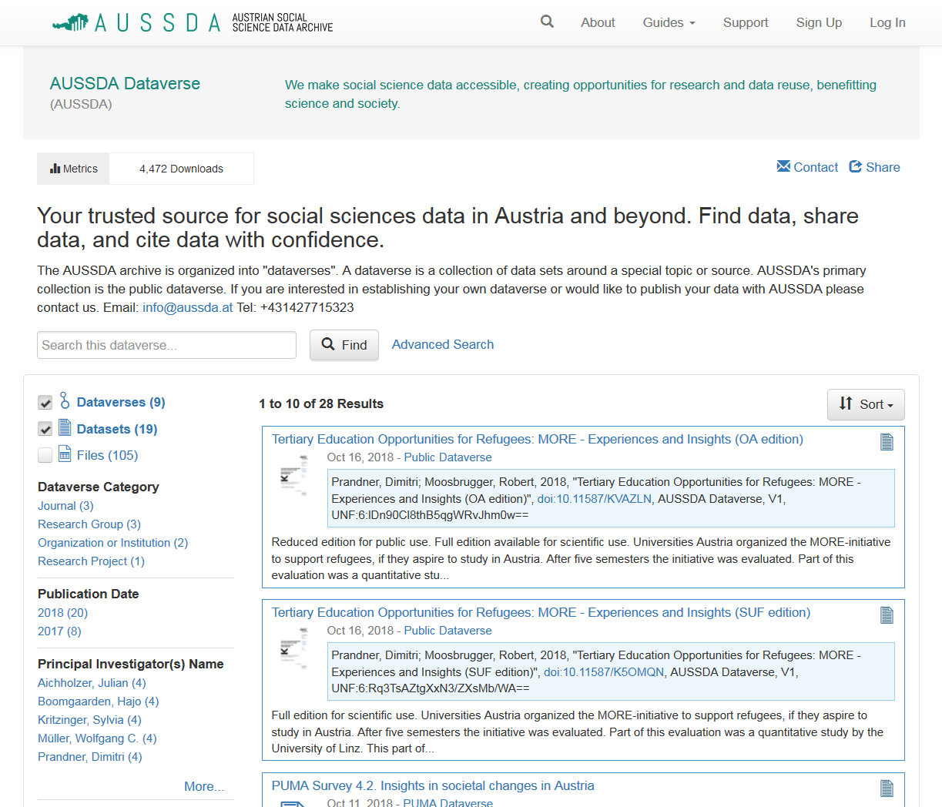
Service: digital repository AUSSDA Dataverse
“Sign Up” to create a new account or “Log In” with your institutional account (participating in EduGain)
View downloads
Search with English terms

Slide 10
Data Culture: Our approaches to openness

Slide 11
Open Definition 2.1 is a useful reference
Open Access
Open Educational Resources
more …
Open Data
Open Definition

Slide 12
Open access is the preferred model for metadata and documentation
Metadata is dedicated to the public domain (CC0)
Documentation about data sets can be published under a Creative Commons Attribution International 4.0 License (CC BY)
Methodological report
Questionnaire
Codebook
Other supplemental material

Slide 13
Open data: We need different licenses matching different needs to maximize reuse
Open Access is available for data published under a Creative Commons Attribution International 4.0 License (CC BY)
Restricted Access is available for data that require restricted use models, e.g., scientific use only (cf. GDPR)
Delayed publication (embargo period) is possible under both models
Contracts with special conditions on reuse are also possible

Slide 14
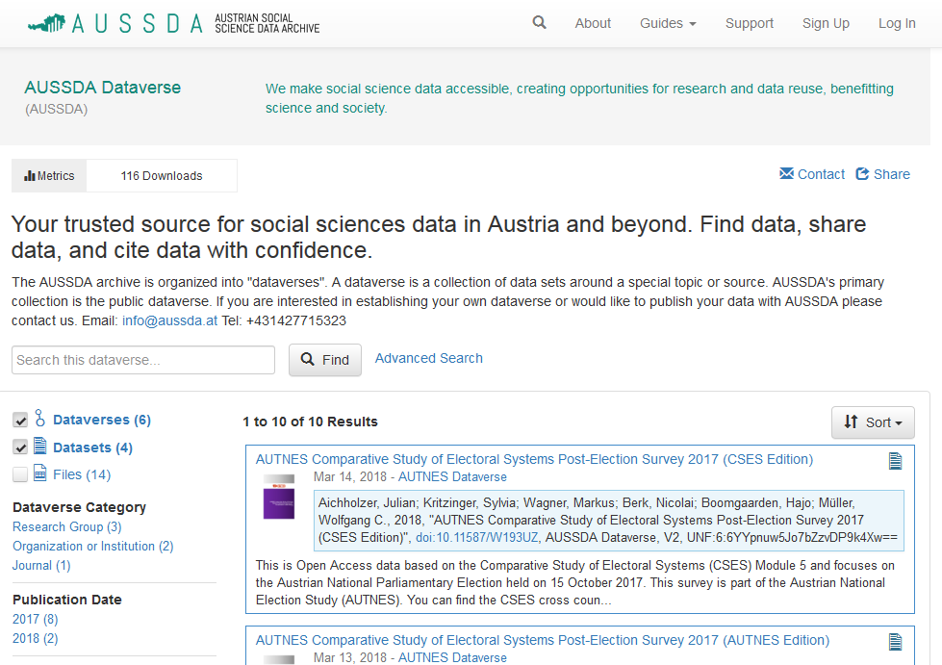
Open Educational Resources Pilot projects in teaching 2018
Data analyses
At the institutes for sociology at JKU and University of Graz
At the faculty for sociology and political science at the University of Innsbruck
In communication science at the University of Salzburg
Information behavior, trust in media, politics in Austria
BLACKBOARD UND DATAVERSE SCREEN

Slide 15
FAIR Data: Turning principles into practice
Two examples

Slide 16
Findable
F1. (Meta)data are assigned a globally unique and persistent identifier
F2. Data are described with rich metadata
F3. Metadata clearly and explicitly include the identifier of the data they describe
F4. (Meta)data are registered or indexed in a searchable resource

Slide 17
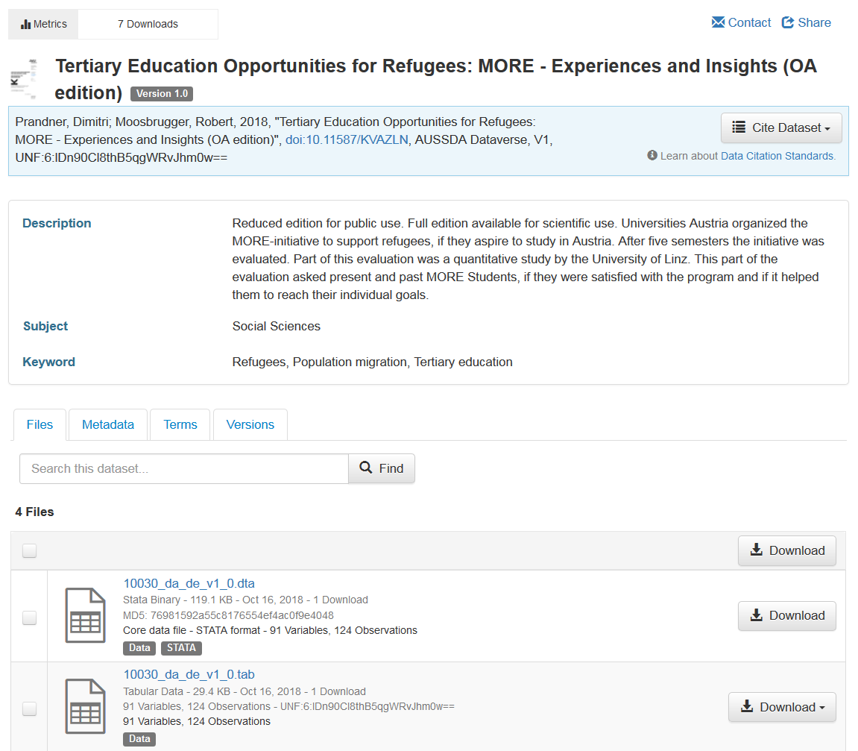
Some answers to findability
OAI-PMH server allows harvesting of metadata. Website has Solr search.
F4
doi as part of metadata
F1, F3
Metadata with specifics about survey research
F2

Slide 18
Reusable
R1. Meta(data) are richly described with a plurality of accurate and relevant attributes
R1.1. (Meta)data are released with a clear and accessible data usage license
R1.2. (Meta)data are associated with detailed provenance
R1.3. (Meta)data meet domain-relevant community standards

Slide 19
Some answers to reusability
How to cite
& methods reports
R1.2
Use of CESSDA metadata model relevant to the social sciences
R1, R1.3
License terms for all files
Metadata marked as CC0
R1.1
Use of controlled vocabularies in metadata

Slide 20
Phase 2
Phase 3
> decisions about documentation
> informed consent (template, digital rights management, licenses for data use)
Data Collection and File Creation
> best practice
> tutorials, trainings
> quality controls
> DDI standard
Project Start-up
Phase 1
Preparing call for tender
Proposal Development and Data Management Plans
Funding letter
> Contact archive for advice
> data management plan
Phase 4
> Manage datasets files
> file structure
> Back up data and documentation (self-archving)
Data Analysis
Phase 7
> Dissemination of data
> Using AUSSDA data in university‘s curricula
Archiving
Outreach
User updates
Phase 6
Phase 5
Publications
> Complete relevant forms
> Comply with dissemination standards and formats
Preparing Data for Sharing
> disclosure risk limitation
> file formats
> Contact archive for advice (licences, embargo)
Depositing Data
Source: Adapted from ICPSR Data Life Cycle

Slide 21
Thank you.
www.aussda.at
info@aussda.at
+43 1 4277 15323
@TheAUSSDA #AUSSDA
AUSSDA in German: https://youtu.be/Y_lKvkCUHuU
AUSSDA in English: https://youtu.be/Ymky27wVGsI

Slide 22
„Data Culture & FAIR Data: AUSSDA – The Austrian Social Science Data Archive“ by Lars Kaczmirek is licensed under a Creative Commons Attribution 4.0 International License.
The license covers only the text on the slides.
Images, the AUSSDA logo and design, the font and other aspects of the presentation may be subject to copyright, trademark and possible other rights.

Slide 23
From data in to data out
Acquisition
Access & Reuse
Preservation
Processing

Slide 24
Support structure
Data
Business development & administration
Data protection & compliance
Customer support & trainings
communi-cation
Technologies

Slide 25
AUSSDA is currently focusing on the following target groups
Researchers
University teachers
Universities and other institutions in higher education
Funding agencies
Other target groups can be addressed in projects, e.g., citizen science

Slide 26
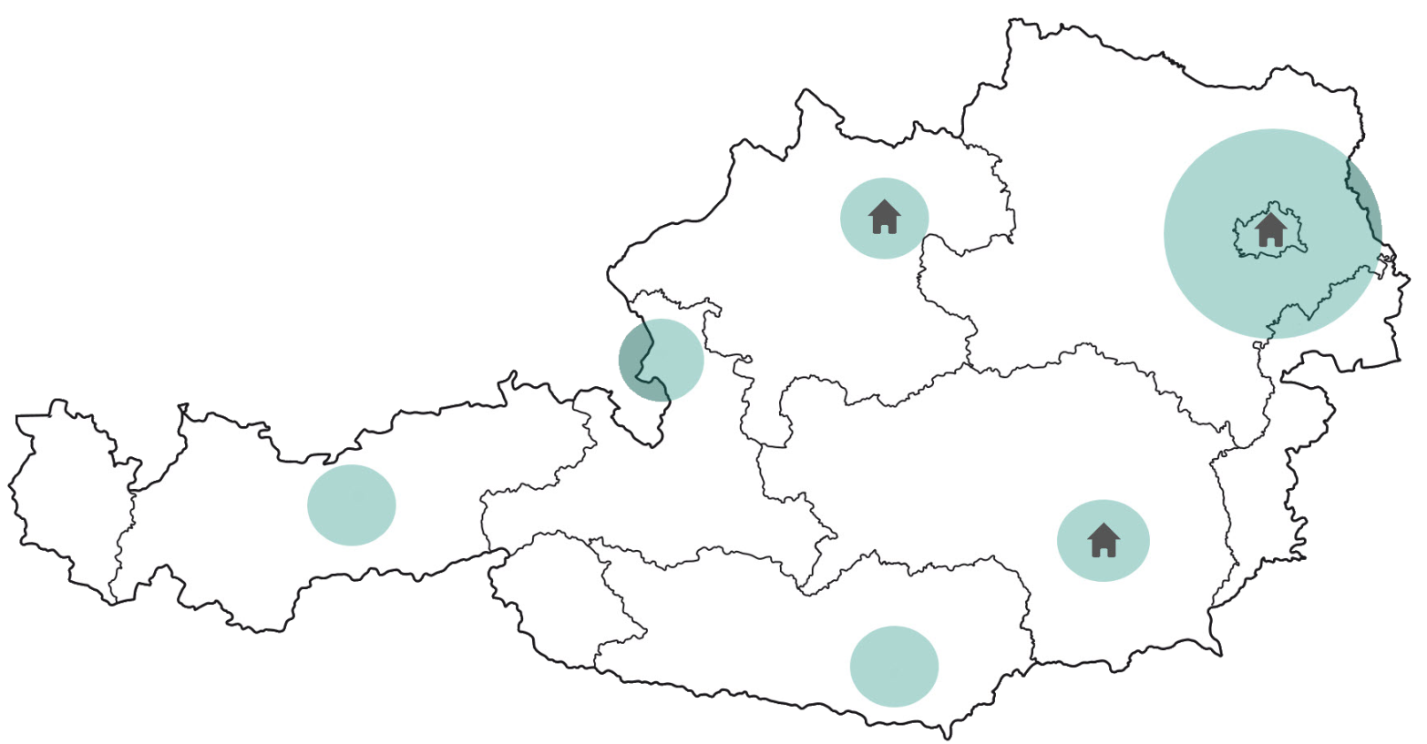
A wide network of support in Austria
Alpen-Adria-Universität Klagenfurt
Bundesministerium für Wissenschaft, Forschung und Wirtschaft (BMWFW)
Forschungsförderungsgesellschaft (FFG)
Institut für Höhere Studien (IHS)
Johannes Kepler Universität Linz
Karl-Franzens-Universität Graz
Leopold-Franzens-Universität Innsbruck
Österreichische Akademie der Wissenschaften (ÖAW)
Österreichisches Institut für Wirtschaftsforschung (WIFO)
Paris-Lodron-Universität Salzburg
Statistik Austria
Universität Wien
Wirtschaftsuniversität Wien
Wissenschaftsfonds (FWF)

