Slide 1

Research Data Alliance Austria
Conference “The European Open Science Cloud: Austria takes initiative”, 30 October 2018, University of Vienna
Barbara Sánchez, TU Wien, RDA Austria, Deputy Chair

Slide 2

What is RDA?
RDA is an international member based organization focused on the development of infrastructure and community activities that reduce barriers to data sharing and exchange, and the acceleration of data driven innovation worldwide.
With more than 7,300 members globally representing 137 countries, RDA includes researchers, scientists and data science professionals working in multiple disciplines, domains and thematic fields and from different types of organisations across the globe.
RDA is building the social and technical bridges that enable open sharing of data to achieve its vision of researchers and innovators openly sharing data across technologies, disciplines, and countries to address the grand challenges of society.
rd-alliance.org/about-rda
WWW.RD-ALLIANCE.ORG
@RESDATALL

Slide 3
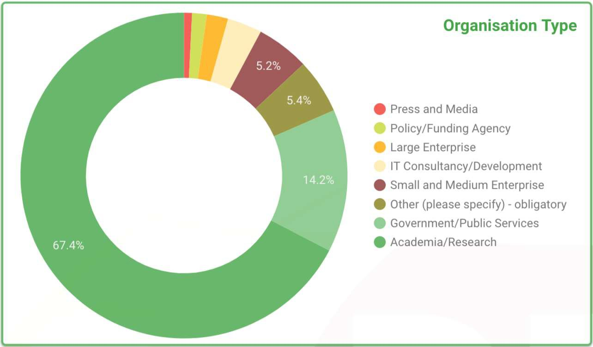
Who is RDA
rd-alliance.org/about-rda
WWW.RD-ALLIANCE.ORG
@RESDATALL

Slide 4
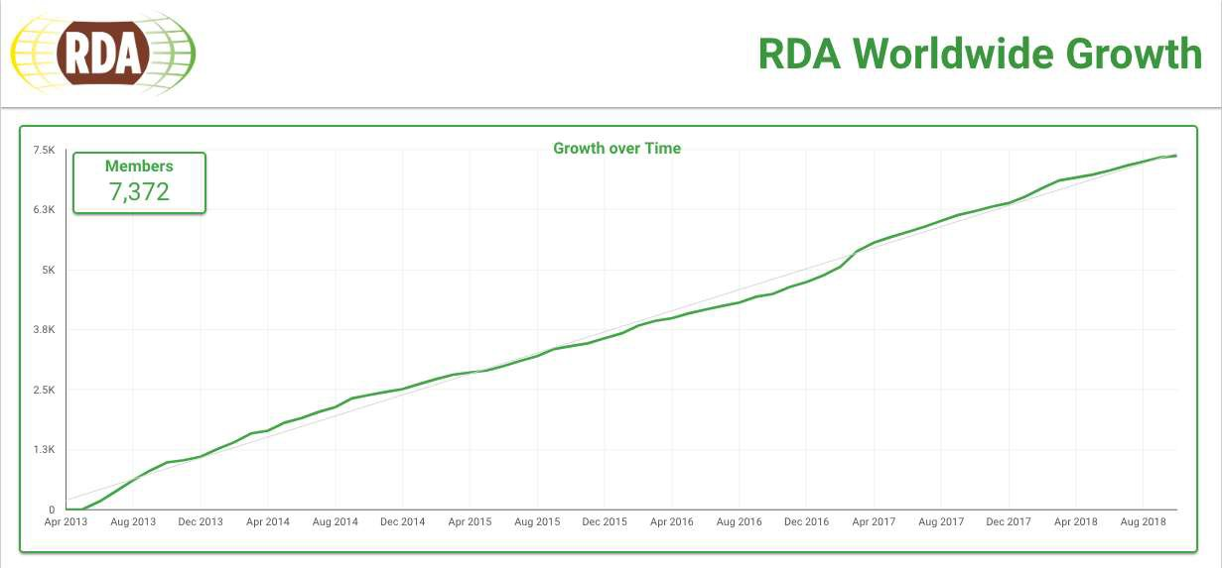
RDA Worldwide Growth
rd-alliance.org/about-rda
WWW.RD-ALLIANCE.ORG
@RESDATALL

Slide 5

RDA Europe
European plug-in to the Research Data Alliance
Launch of RDA Europe 4.0 in March 2018
Mandated to become the centrepiece for an EU Open Science Strategy
Establishment of a network of national nodes to foster adoption of RDA outputs in the region
Calls to expand the network via a cascading grant funding mechanism

Slide 6

RDA in Austria
Serve cross border as a professional connector for global RDM and data sharing activities
Go for practical approaches
Initiate concrete adoption projects to disseminate outputs from RDA global initiatives on a national level
Organize events and trainings that promote best practices in RDM
Promote local adoption of RDA recommendations
Connect Austrian research data stakeholders

Slide 7
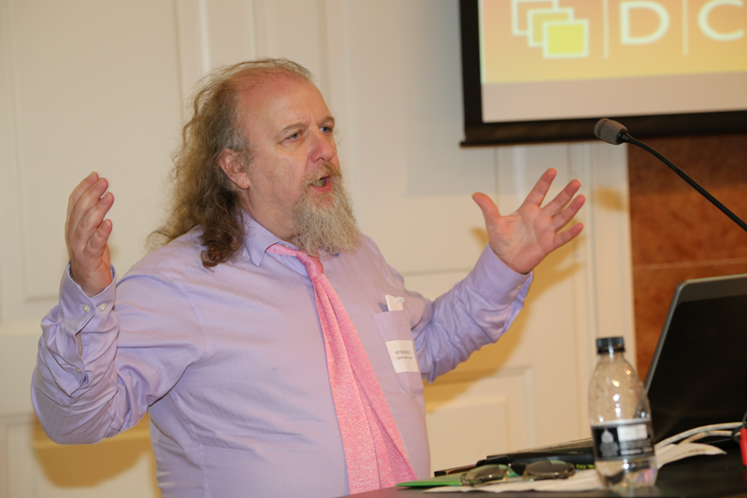
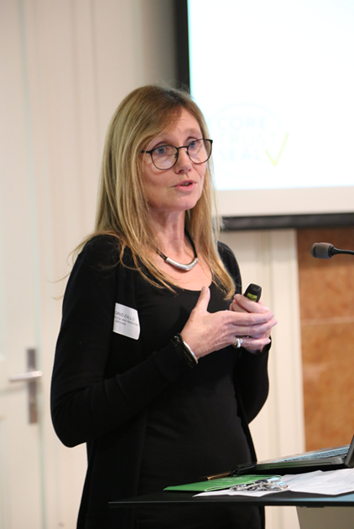
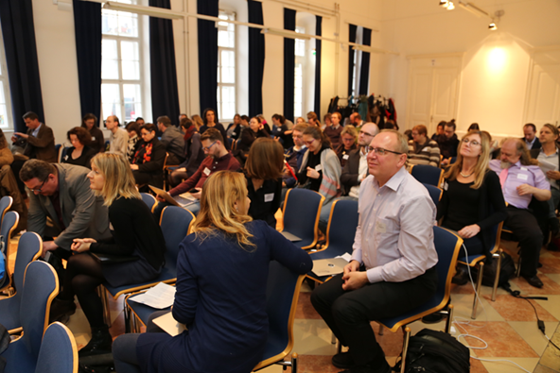
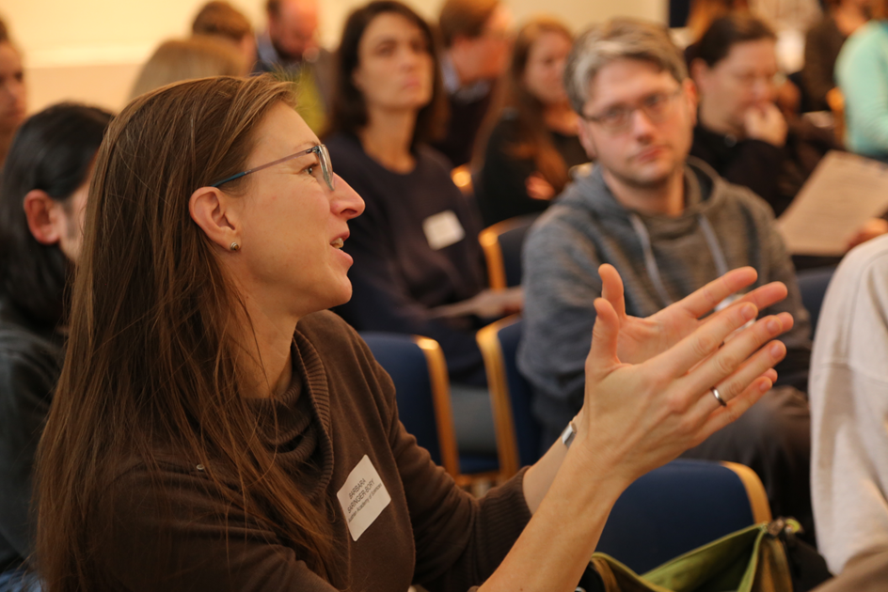
RDA Austria - Preparatory Workshop in Vienna
“Data Stewardship Realized: From Planning to Action. Towards the Establishment of an Austrian Research Infrastructure”, November 2017
Organized with the support of RDA Europe, the University of Vienna and the TU Wien

Slide 8
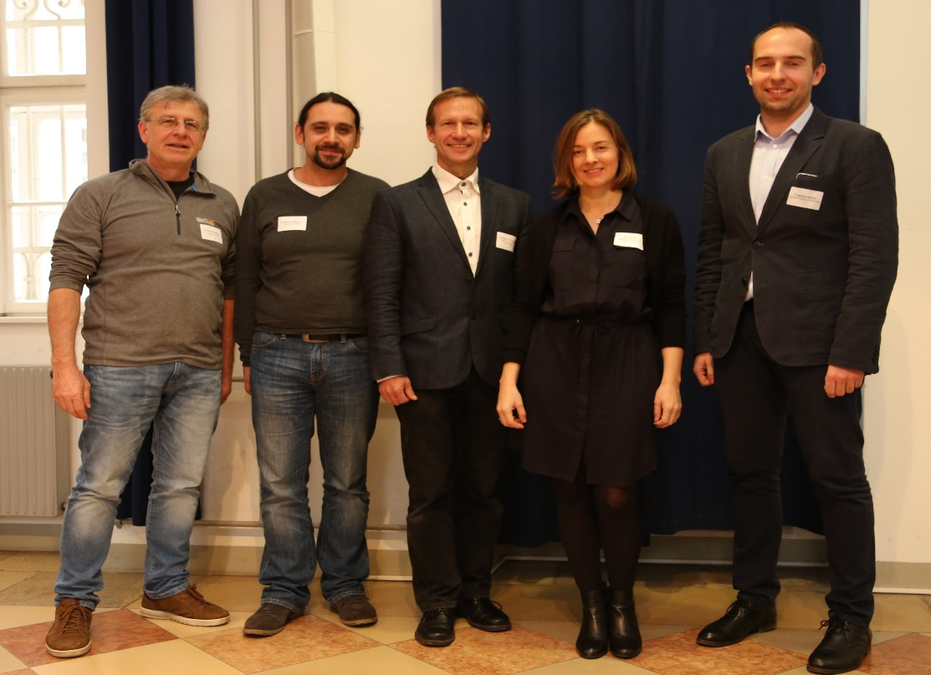
Formation of RDA Austria
November 2017 Dedicated RDA group for Austria to formally represent the Austrian data management community
December 2017 Constitutive General Assembly of RDA Austria
March 2018 First Member Forum
Foundation committee: Paolo Budroni, Raman Ganguly, Andreas Rauber, Barbara Sánchez, Tomasz Miksa (not in the picture: Seyavash Amini)

Slide 9
Members of RDA Austria
The Austrian community responded quickly to the invitation to build the social and technical bridges that enable open sharing of data
3 institutional members: TU Wien, University of Vienna, Know-Center Graz
28 individual members from various Austrian research institutions from five federal provinces
Contact established with: GOFAIR, OpenAIRE, e-Infrastructures Austria

Slide 10
Austria: Planned Working Groups____
Data citation, discovery and reuse
GDPR and research data
Research data management policies and services for academia, industry and SMEs
Machine-actionable data management plans
Specific challenges concerning research data in the digital humanities

Slide 11
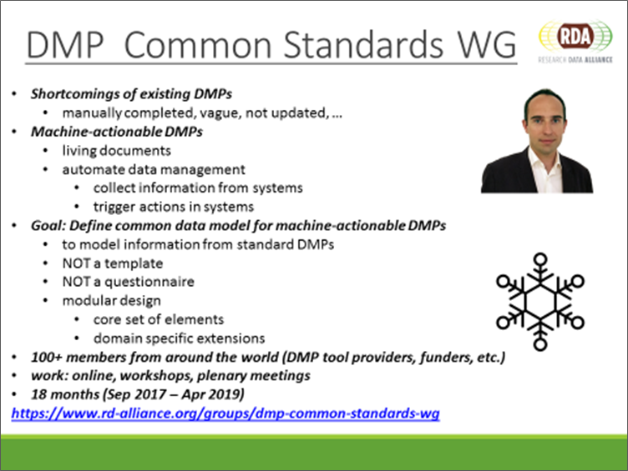
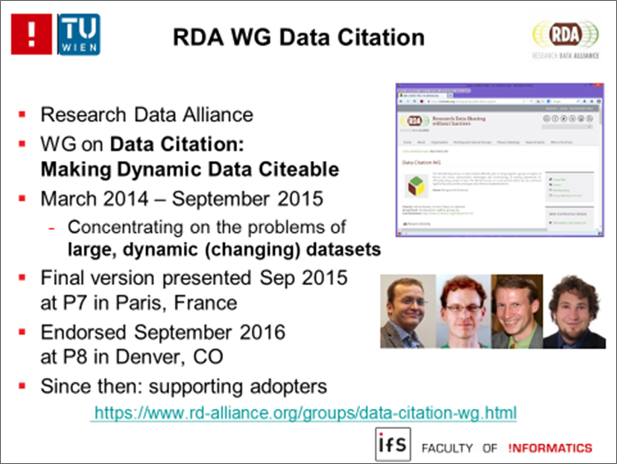
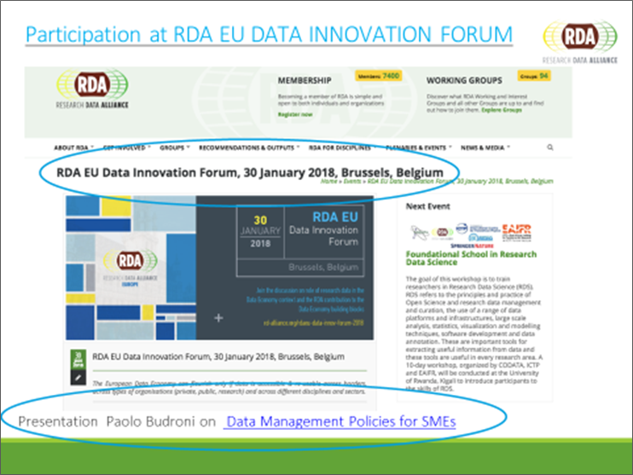

Slide 12
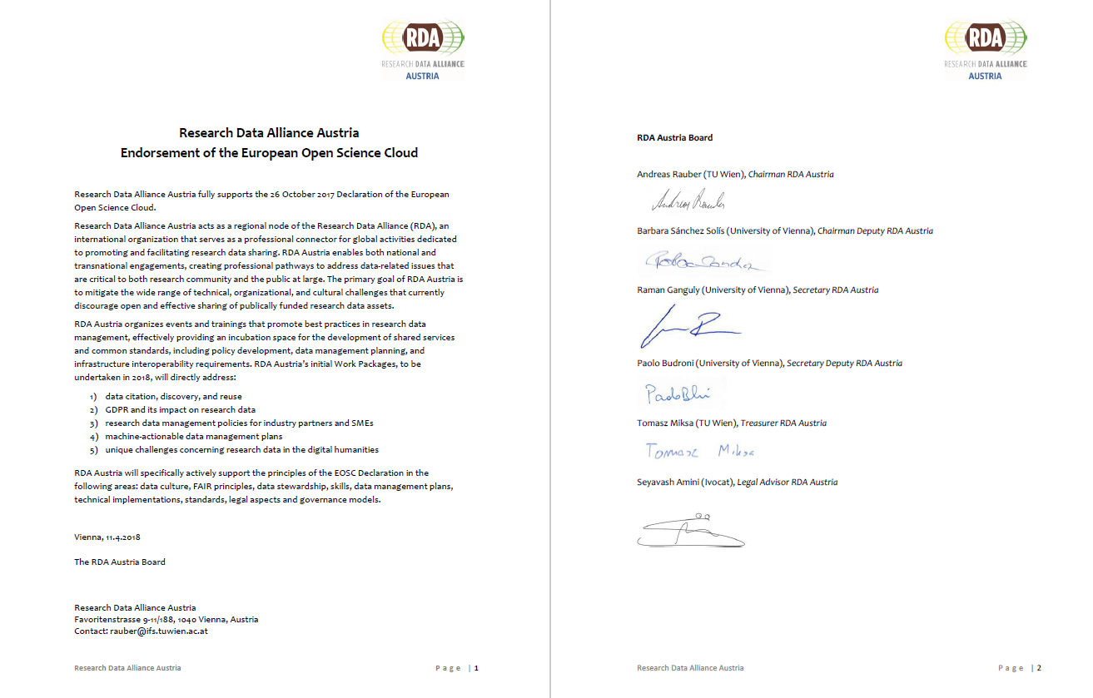
Endorsement of the EOSC
On 11 April 2018, RDA Austria sent an endorsement to the October 2017 Declaration of the European Open Science Cloud

Slide 13
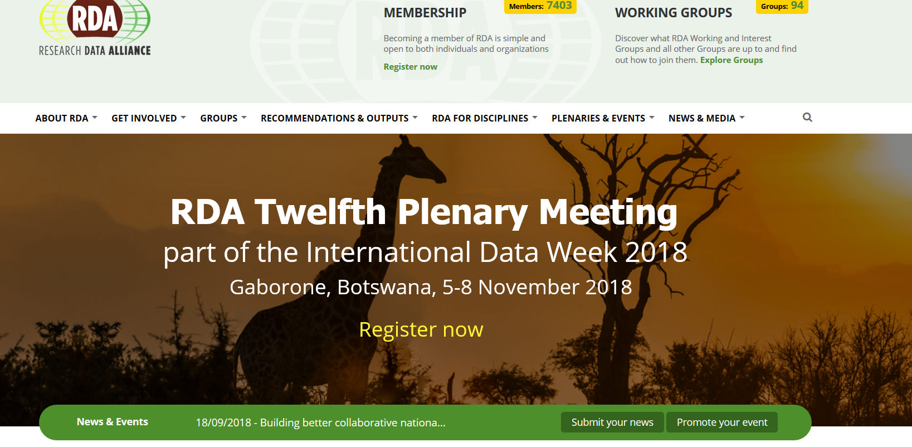
Digital Frontiers of Global Science
To find out more visit:
https://www.rd-alliance.org/plenaries/rda-twelfth-plenary-meeting-part-international-data-week-2018-gaborone-botswana
rd-alliance.org/plenaries
WWW.RD-ALLIANCE.ORG
@RESDATALL
CC BY-SA 4.0

Slide 14
Linking to training initiatives
Outlook April 2019:
Train-the-trainer workshop on GO Change, GO Train, Go Build in cooperation with the project e-Infrastructures Austria – WP2 “Creation of GOFAIR Reference Points at Austrian Research Institutions”, in cooperation with GOFAIR International and OpenAIRE

Slide 15

Contact RDA Austria – Board
Email: info@rd-alliance.at
Contact RDA Global:
Email: enquiries@rd-alliance.org
Web: www.rd-alliance.org
Twitter: @resdatall
Andreas Rauber, TU Wien, Chairman | rauber@ifs.tuwien.ac.at
Barbara Sánchez Solís, TU Wien, Chairman Deputy | barbara.sanchez@tuwien.ac.at
Raman Ganguly, University of Vienna, Secretary | raman.ganguly@univie.ac.at
Tomasz Miksa, TU Wien, Treasurer | miksa@ifs.tuwien.ac.at
Paolo Budroni, University of Vienna, Secretary Deputy | paolo.budroni@univie.ac.at
Seyavash Amini, Ivocat, Legal Advisor | amini@ivocat.de
Slides partly taken from RDA Global,
Slideshare - http://www.slideshare.net/ResearchDataAlliance

