Slide 1


Earth Observation Data Centre
Wolfgang Wagner
Department of Geodesy and Geoinformation (GEO)
Vienna University of Technology (TU Wien)
Earth Observation Data Centre for Water Resources Monitoring (EODC)

Slide 2
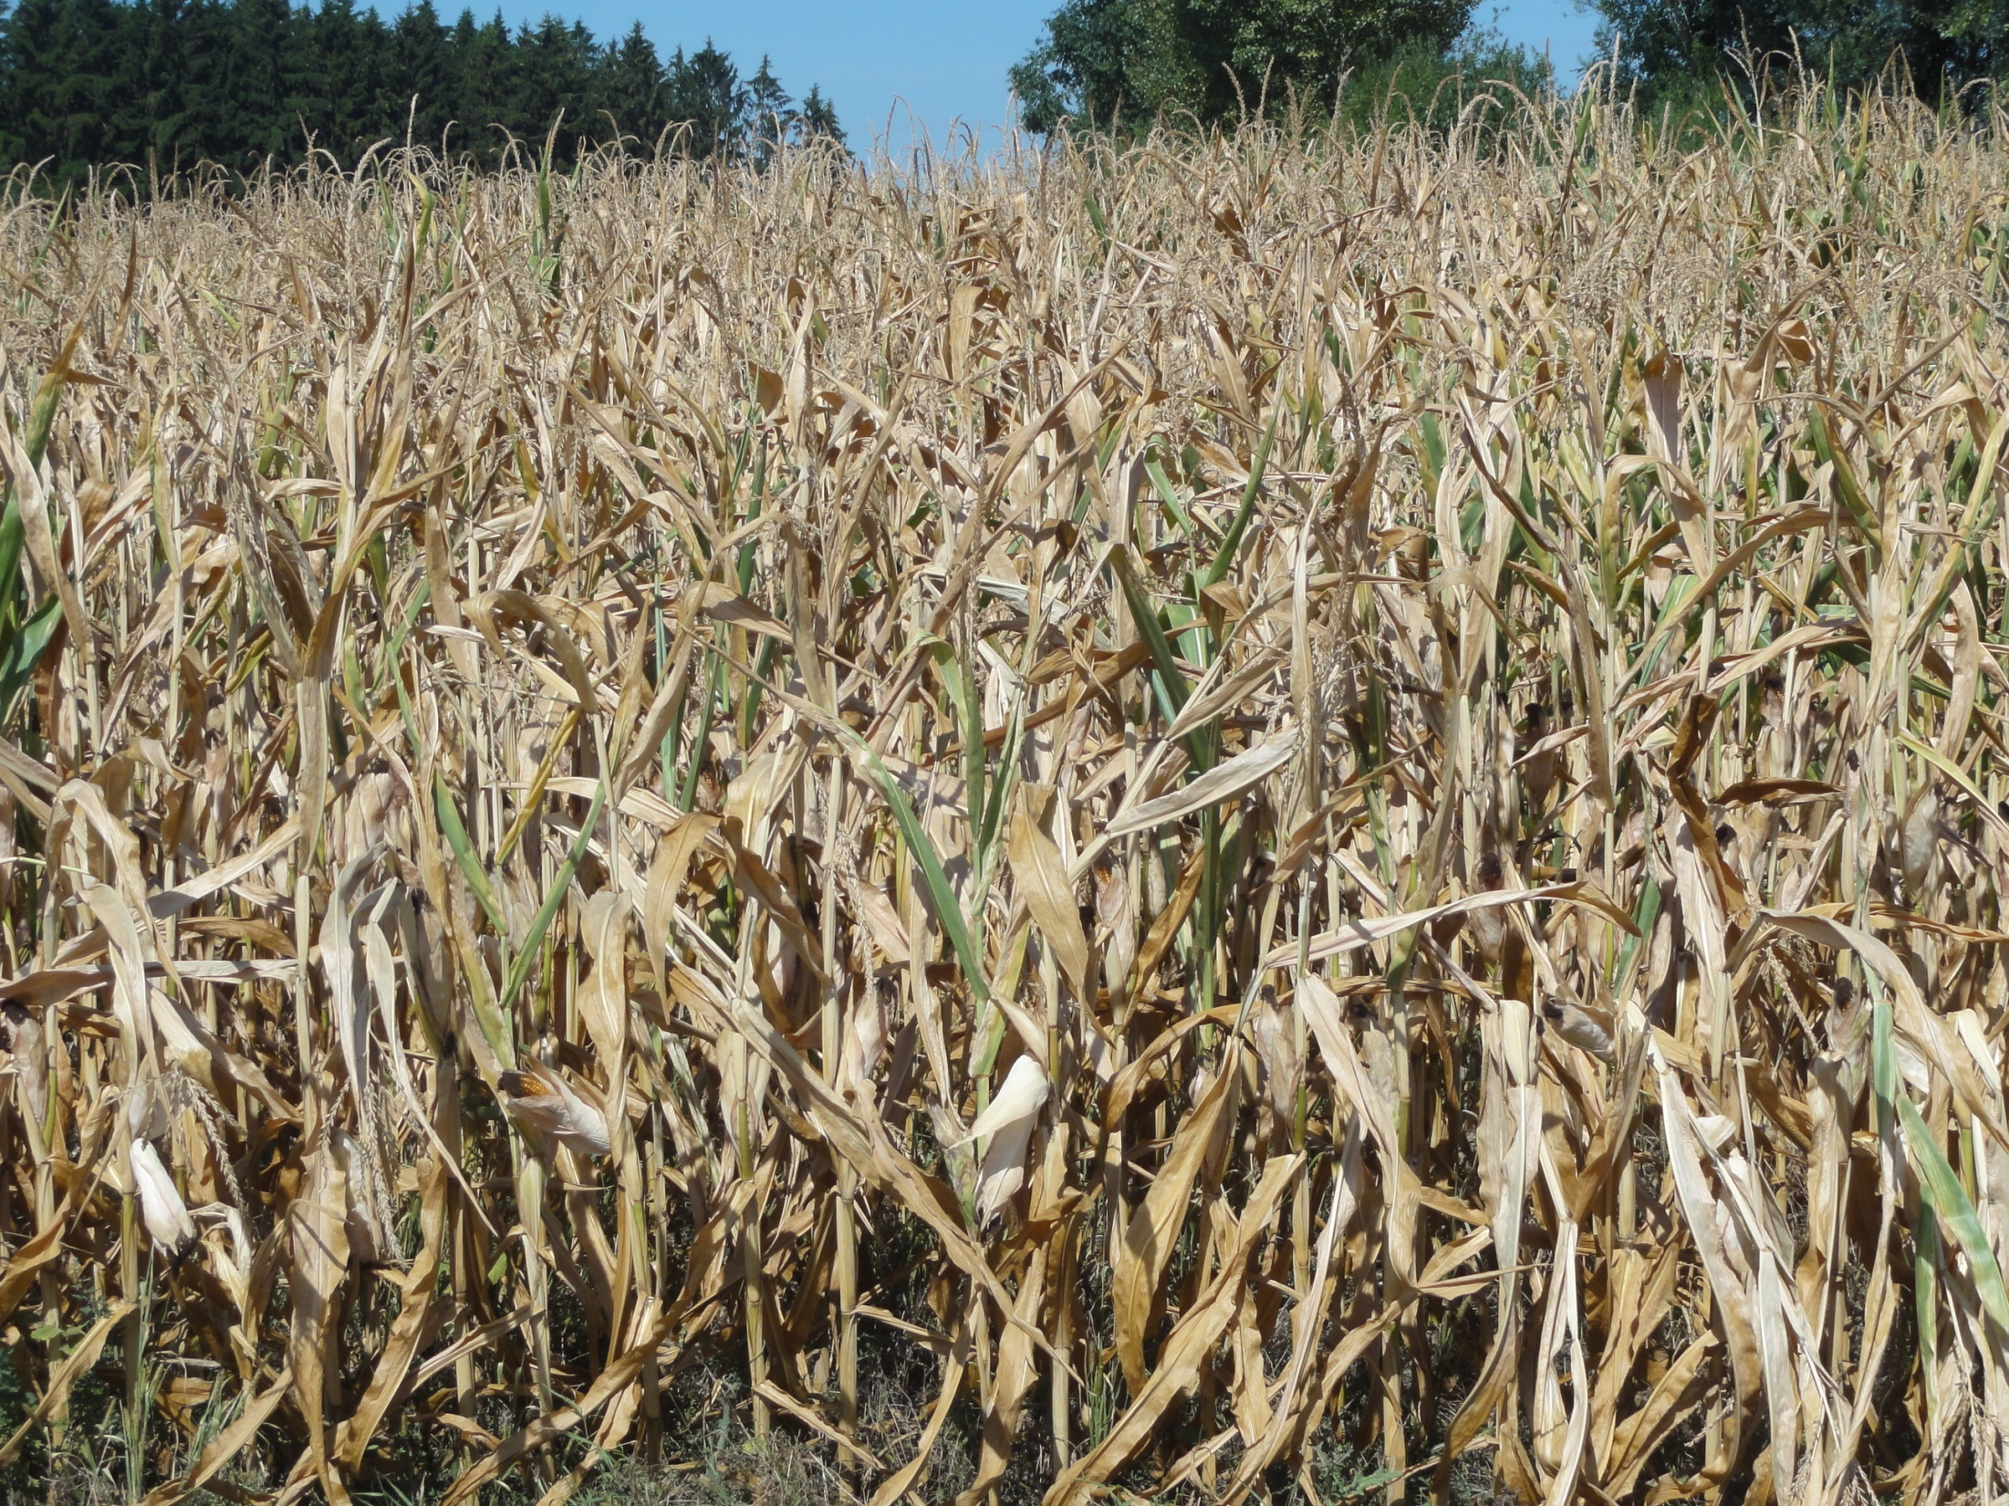
Corn Field in Upper Austria 31 August 2015

Slide 3
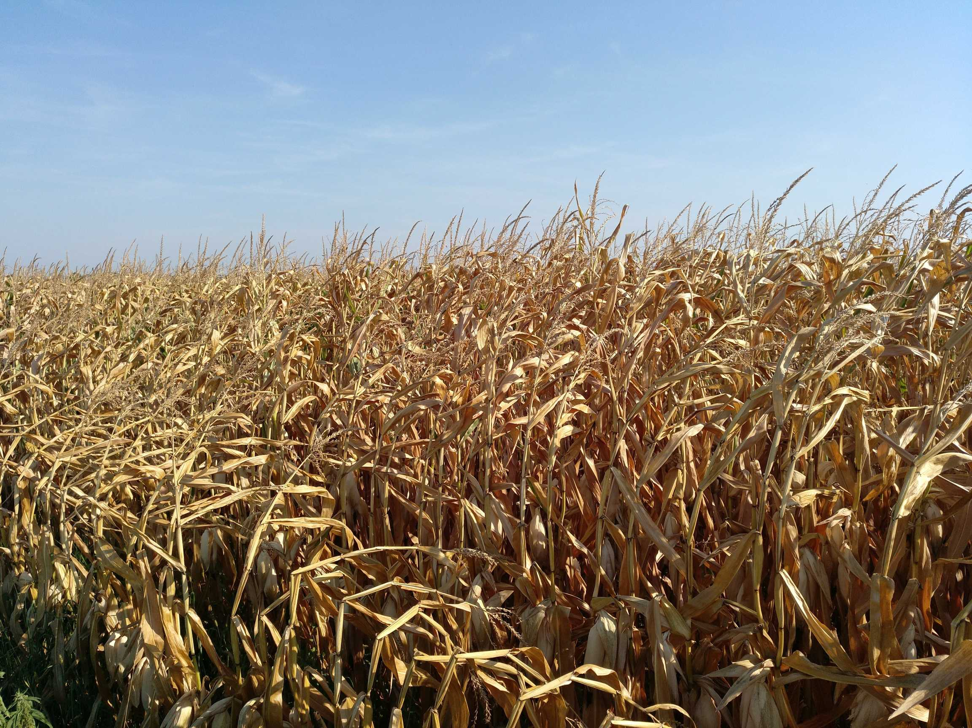
Corn Field in Upper Austria 19 August 2018

Slide 4
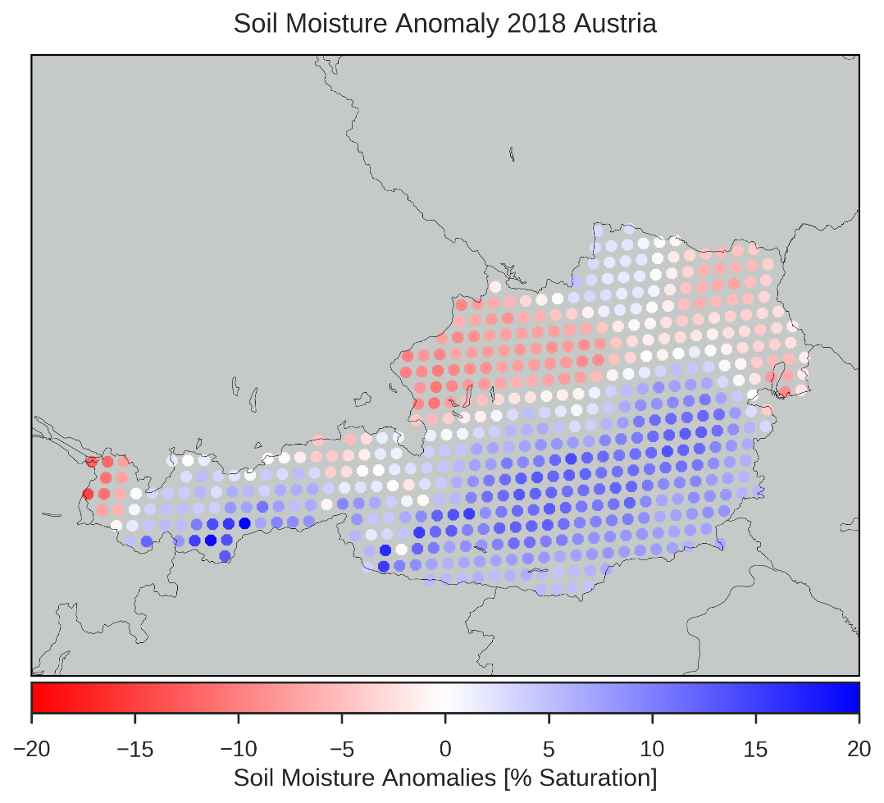

Satellite Soil Moisture Anomalies over Austria 2018
ASCAT soil moisture compared to 2007-2017
Data were detrended to account for land cover changes
Snow and frozen soil conditions were masked

Slide 5
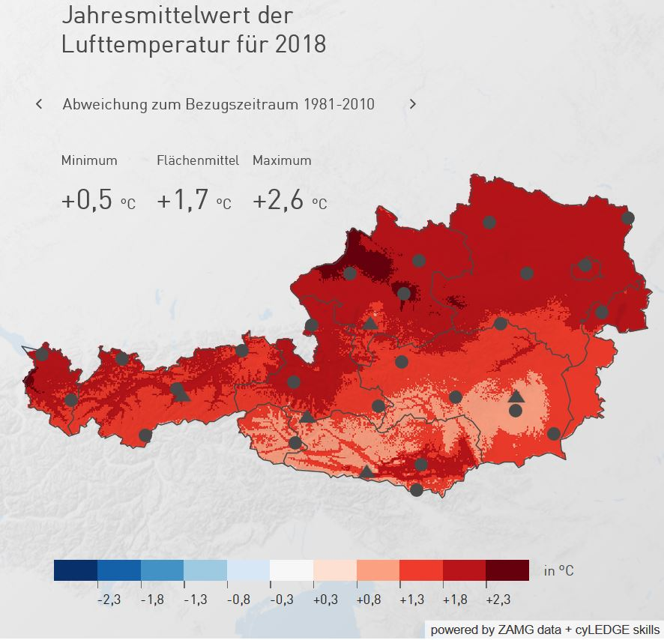
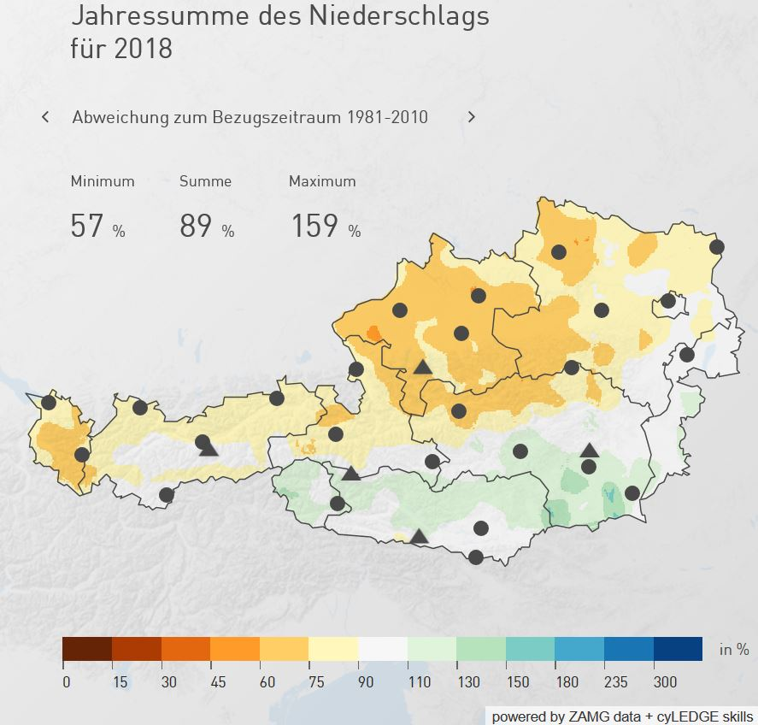

Climate in Austria in 2018
Temperature Anomaly
Rainfall Anomaly
https://www.zamg.ac.at/cms/de/klima/klima-aktuell/klimamonitoring/
Data query on 20/10/2018

Slide 6
Earth Observation: A European Success Story
Meteorological Satellites
Copernicus-Satellites
Science-Missions

Slide 7
↑40 %
per year
Doubling every two years
► Data Volume
► Number of transistors (Moore’s law)
► Disk
► CPU
Bandwidth
↑25 %
per year
Years

Slide 8
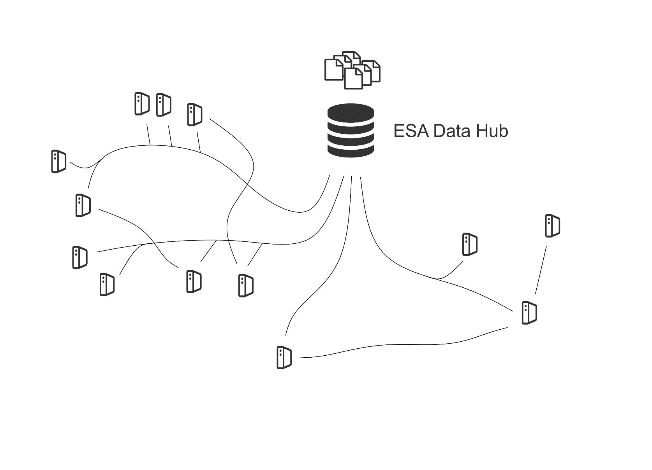
EO Ground Segment – The Past

Slide 9
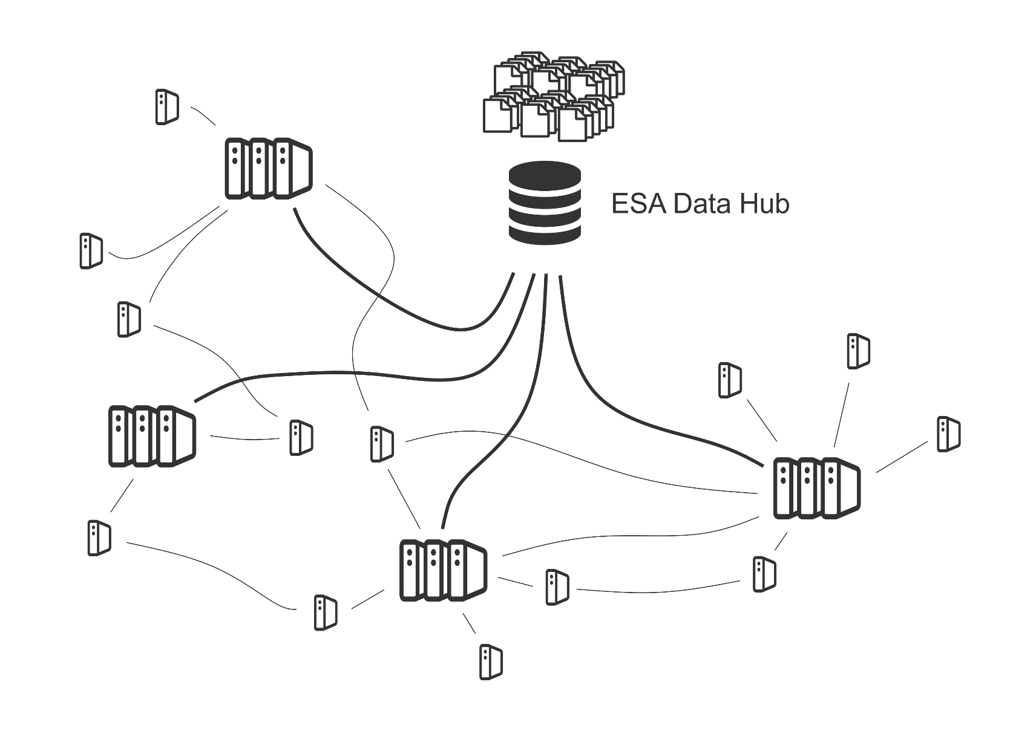
EO Ground Segment – The Future

Slide 10

The Formation of a Network of EO Cloud Platforms
Reaching a critical mass is essential for user uptake
How to scale up?
  Private capital → Google, Amazon, …
  Public investments → CODE-DE, Copernicus DIAS …
  Cooperatives → EODC, Supercomputing Centres
Publicly-funded
Data Centres
Cooperative Data Centres
Commercial
Data Centres

Slide 11
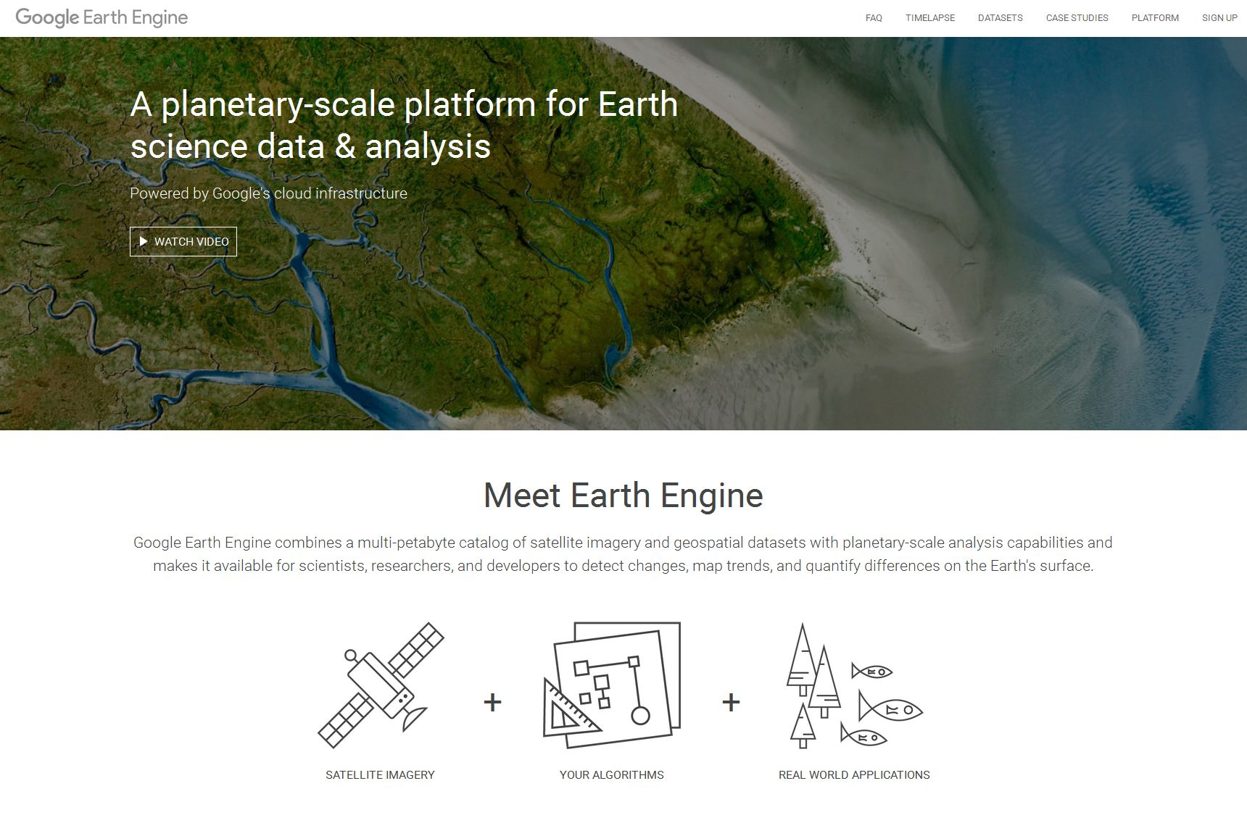
https://earthengine.google.com/
Gorelick et al. (2017) Google Earth Engine: Planetary-scale geospatial analysis for everyone, Remote Sensing of Environment 202, 18-27

Slide 12







Data Access and Information Services (DIAS)
Copernicus is managed by the EC’s Directorate-General for Internal Market, Industry, Entrepreneurship and SMEs (DG Growth)
implemented by
led by Creotech Instruments S.A.
led by Atos
led by Serco Italia S.p.A.
led by Airbus
implemented by EUMETSAT, ECMWF and Mercator-Ocean

Slide 13



Earth Observation Data Centre
Collaboration for Earth Observation
Public-private partnership
Building a federated multi-owner IT infrastructure for
  Scientists
  Public services
  Innovators
Users are partners who participate in decision making
Development of collaborative services
  From data to model predictions
Petabyte Storage
Supercomputing
Cloud Platform
https://www.eodc.eu/

Slide 14
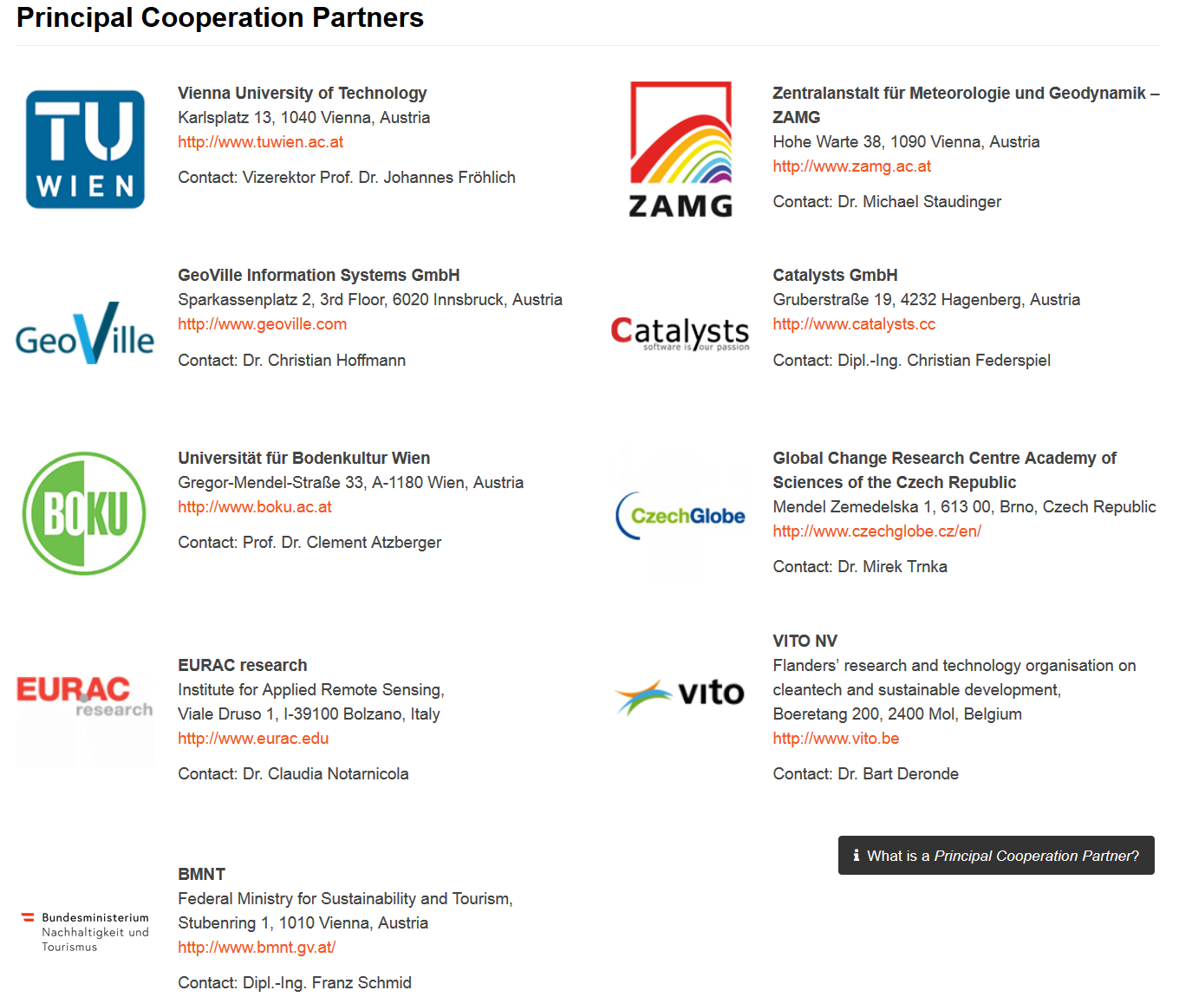



Slide 15
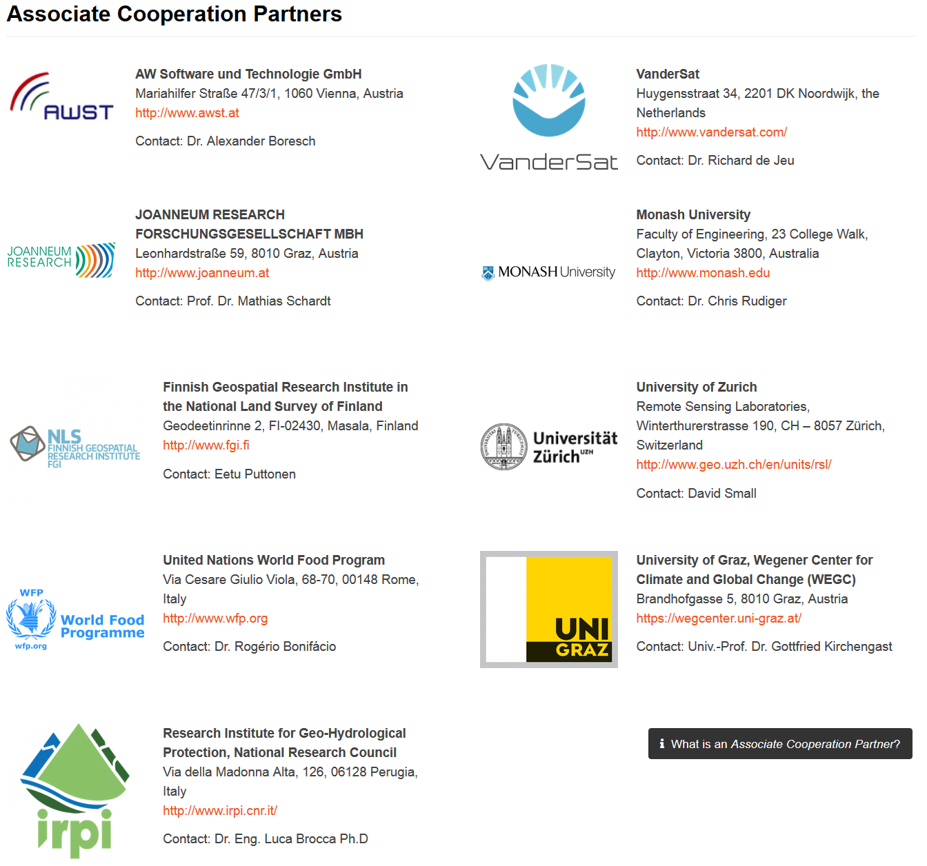

Slide 16
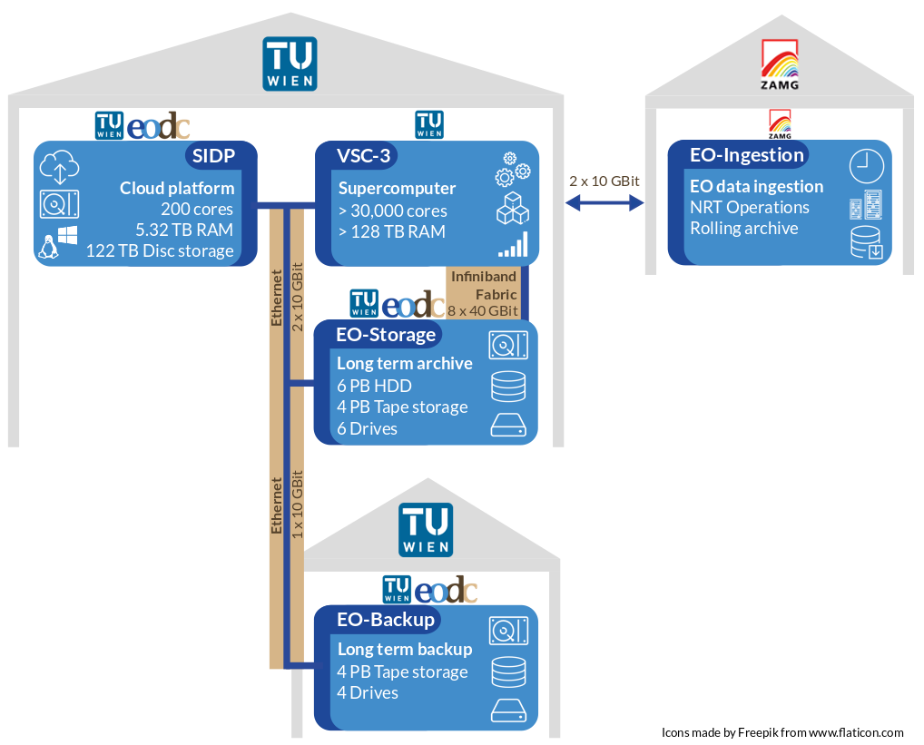
EODC Infrastructure @ TU Wien & ZAMG

Slide 17
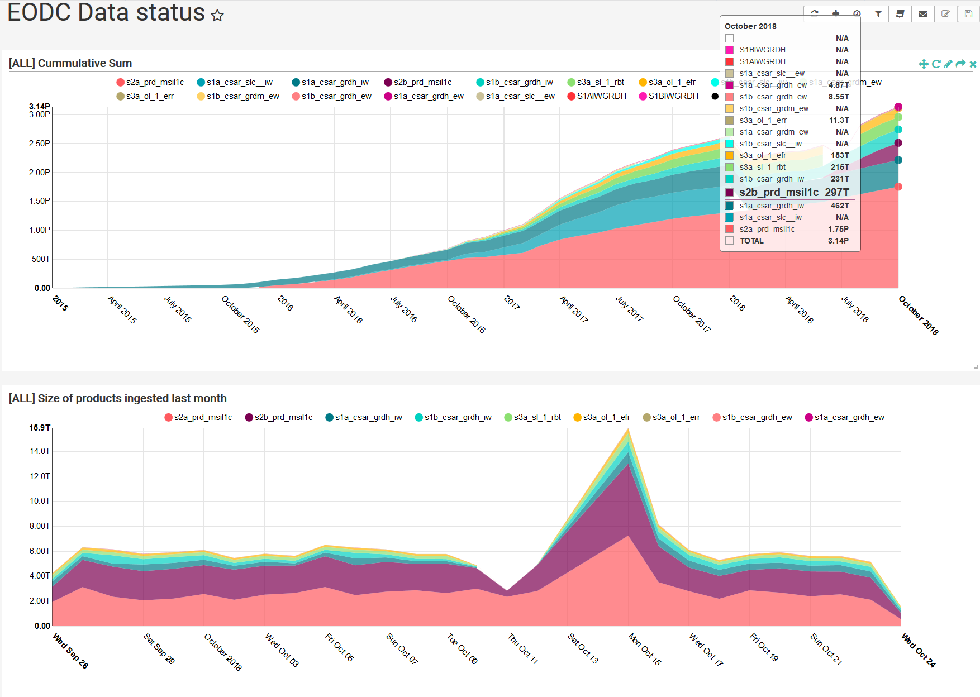
https://eomonitor.eodc.eu/superset/dashboard/datastatus/

Slide 18
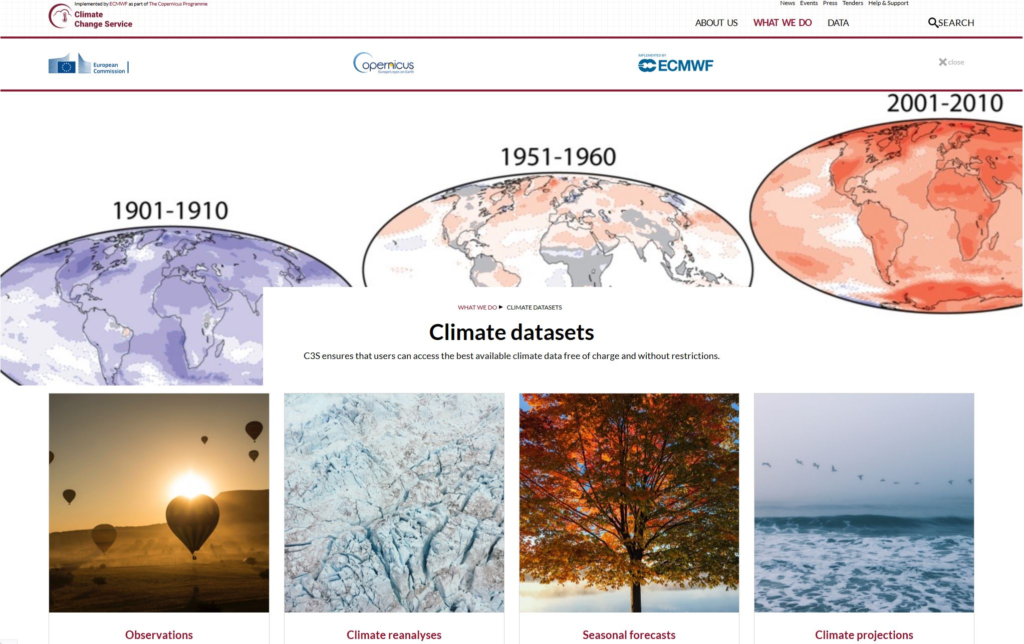
Copernicus Climate Change Service (C3S)
https://climate.copernicus.eu/climate-datasets

Slide 19


Interoperability of Platforms
openEO develops an open API to connect R, python, javascript and other clients to big Earth observation cloud back-ends
Python
R
JavaScript
http://openeo.org/
H2020
EODC
VITO
Sinergise
GEE
https://github.com/open-eo/

Slide 20

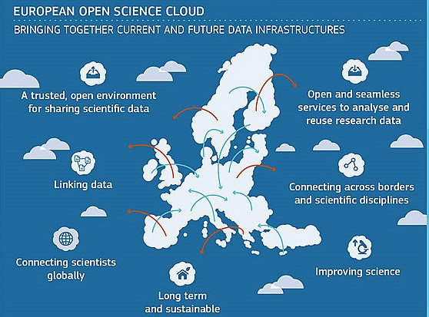
Towards the Integration of Research Infrastructures
In Earth Observation (EO), nobody can do it all
Formation of a network of transnational thematic data centres is essential to make best use of the increasing wealth of EO data
Current EO infrastructure
programmes of DG Growth
and ESA mainly aim to
stimulate industry
EO science needs its own
infrastructures
  Sovereignty
  Scientific independence
  Train next generation of
  students
Acknowledgements
BMWFW: GEOCLIM Data Infrastructure Austria
Vienna Business Agency: ID-Nr. 1430171 “Sentinel Big Data Science Cluster”
Austrian Space Application Programme: BMon
Copernicus Climate Change Service: C3S 312b Lot 4
H2020: EO-2017 Number 776242 “openEO”

