Slide 1
The European Open Science Cloud Austria takes initiative
Vienna
9:30 – 17:00

Slide 2
The European Open Science Cloud. Domestic experiences vs the pan- European experiences
Panel Discussion 16:00 – 16:45
Moderation
Paolo Budroni
University of Vienna
Twitter #eosc18 - Livestream https://eosc18-ati.univie.ac.at/live/

Slide 3
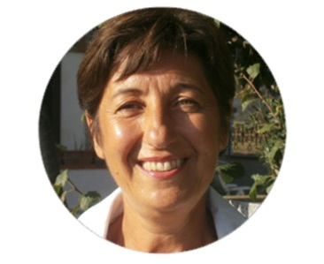
Donatella Castelli
Donatella Castelli is a Research Director at Istituto di Scienza e Tecnologie della Informazione “A. Faedo” of the Italian National Research Council (CNR-ISTI). She has been the principal investigator of several European and International funded projects on digital libraries and data e-Infrastructures acquiring considerable experience in these domains.
Currently, she is the technical director of OpenAIRE, the Open Access infrastructure for Research in Europe, and she leads the definition of the Architecture of the European Open Science Cloud in the EU EOSCPilot project.
She is also co-designed the D4Science data Infrastructure that is currently supporting more than one hundred virtual research environments from multiple domains including marine biodiversity, fisheries, social science, humanities and geothermal science. Her scientific interests are centered on data modeling, data interoperability and data infrastructures.

Slide 4
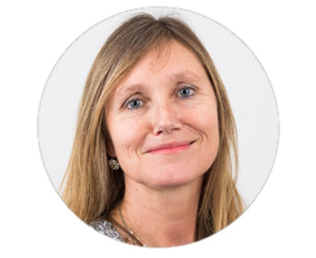
Ingrid Dillo
Dr Ingrid Dillo is Deputy Director at DANS (Data Archiving and Networked Services) in the Netherlands. She holds a PhD in history and has worked in the field of policy development for the last 30 years, including as senior policy advisor at the Dutch Ministry of Education, Culture and Science and the National Library of the Netherlands (KB).
Among her areas of expertise are research data management and the certification of digital repositories.
Ingrid is Co Chair of the Research Data Alliance (RDA) Council.
She is also Treasurer of the Board of CoreTrustSeal (CTS) and Vice Chair of the Scientific Committee of the ICSU/World Data System (WDS).

Slide 5
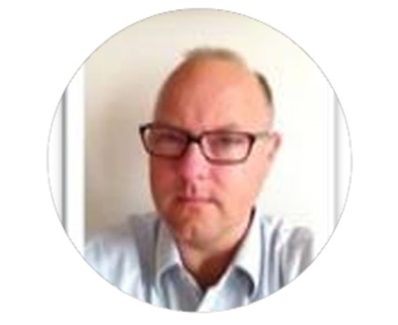
Stefan Hanslik
Stefan Hanslik, Ph.D., Federal Ministry of Education, Science and Research, Head of Unit Technical Science.
Delegate: Euratom Programme Committee (‘Fission’ configuration), OECD-Working Party on Biotechnology, Council of ESRF (European Synchrotron Radiation Facility), High Level Group of EU Member States and Associated Countries on Nanosciences, Nanotechnologies and Advanced Materials.
Expert: PC-NMPB (=Nanotechnologies, Advanced materials, Biotechnology, Advanced manufacturing and processing), PC-Research Infrastructures, member of the ERC-FET-MSCA Programme Committee. NCP: JRC National Contact Point.

Slide 6
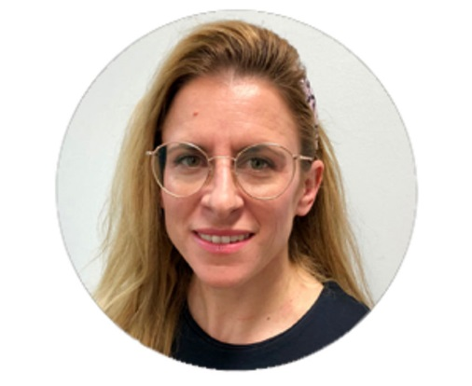
Judith Rabfogel-Scheer
Judith Rabfogel-Scheer is…
senior policy officer at the directorate for Innovation, BMVIT /III/ I2.
former program officer for - talents to foster youth involvement in science and research
in charge of the platform open4innovation.at seeking to open the access to research and technology results
Founding member of the Austrian informal, interministerial working group on the European Open Science Cloud
Austrian delegate to the ERAC standing Working Group on Open Science and Innovation
Master in political science from the University of Oslo and Magistra of philosophy and Judaic studies from the University of Vienna.
Her mission is to open innovation by involving all stakeholders in an inclusive manner. Use Case Austria – important to have shared Austrian/MS and European/EC communication to allow national coordination – the basis to create a sustainable European - EOSC - ecosystem (see also ERAC SWG OSI opinion on the EOSC Governance Models and Strategic Implementation Plan, ERAC 1212/18).

Slide 7
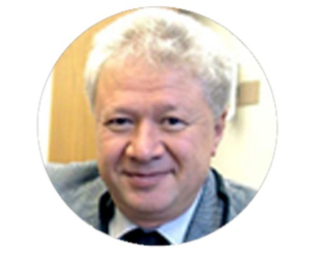
Peter Stanchev
Peter Stanchev is a professor in the Software Engineering and Information Systems Department at the Institute of Mathematics and Informatics, Bulgarian Academy of Sciences. He has forty-five years of professional experience in multimedia systems, database systems, multimedia semantics, education, open access to scientific information and data and medical systems.
Serving also on many database and multimedia conference program committees, he is currently editor-in-chief and member of the editorial boards of several journals.
He is the Bulgarian representative in the EU OpenAIRE projects since 2008.

Slide 8
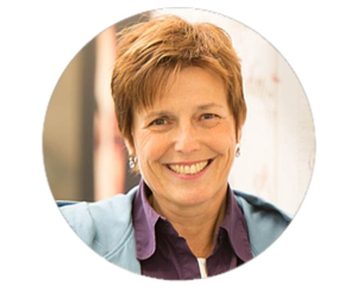
Gabriele von Voigt
Prof. Dr. Gabriele von Voigt is Professor at Leibniz University Hanover (LUH) where she leads the institute Computational Health Informatics.
Her Ph.D. was on the design of user interfaces for medical workstations and her Habilitation was dedicated to the application of virtual reality within medicine.
Apart from employments as a lecturer, project member and project leader in various areas of Computer Science, she worked as the head of information services, was the project leader for the installation of SAP in a University Hospital, and run the computing centre of LUH.
Currently she is the Chair of the European e-Infrastructure Reflection Group (e-IRG).

Slide 9
Donatella Castelli
„EOSC should provide the necessary framework and digital technologies for enabling a new approach to the scientific process based on cooperative work and new ways of disseminating knowledge, improving accessibility to and re-usability of research outputs.
As such it should also promote and facilitate Open Access.
I would promote EOSC giving visibility to early adopters use cases, showing advantages in concrete, also through dedicated hands-on training“.

Slide 10
Stefan Hanslik
“In recent years we have made a lot of effort in Europe to open up access to data to all researchers.
Now we are making a true leap forward: Europe is moving towards the establishment of an effective European Open Science Cloud (EOSC), which will help create a trusted environment for hosting and processing research data to support EU science in its global leading role and will revolutionise access to research data across Europe.
It is very clear to me that the EOSC should be a pan-European federation of existing and planned data infrastructures, a federation that respects the governance and funding mechanisms of its individual components; we should intend to build a scientific cloud “made in Europe”.

Slide 11
Ingrid Dillo
“After having a 1000 or more e-, research and data infrastructures blossom, it is only logical to prune and graft the plants in the infrastructure garden. Will the EOSC be a strictly and formally organized French garden, or will it have the looser and more natural English landscape garden style? And be aware, it takes many years to grow a garden. It needs a lot of care. But if you love your garden, you don’t mind working in it.
From the perspective of a national data service provider like DANS, the creation of an EOSC sometimes feels like a daunting task, but the concept of a trusted and FAIR European environment for sharing and reusing research data is also an inspiration and a catalyst for action and movement in the right direction.”

Slide 12
Judith Rabfogel-Scheer
“We at BMVIT aim to foster innovation and technology by supporting foresight solutions to solve the grand challenges. This needs clear communication, governance and policies, pilots also on RTI data to set up our shared, sustainable European data-service ecosystem - which is our vision of a EOSC 2.0”

Slide 13
Peter Stanchev
“The European Open Science Cloud is like autonomous cars. The technology behind the construction is known, but when it comes to use, there are many legal, organizational and bureaucratic issues.”

Slide 14
Gabriele von Voigt
“The success of EOSC requires an EU wide concept with a suitable structure.
The national nodes play a major role. They have to be coordinated and goal-orientated.
Three important issues are suitable: governance structure, production and innovation efforts, dealing with computing, network and data.”

Slide 15
The European Open Science Cloud Austria takes initiative
Vienna
9:30 – 17:00

