Slide 1
Open Scholarship: the Role and Importance of the European Open Science Cloud (EOSC)
Dr Paul Ayris
Pro-Vice-Provost (UCL Library Services)
CEO, UCL Press
E-mail: p.ayris@ucl.ac.uk
Twitter: @ucylpay

Slide 3
LERU has produced an Open Science Roadmap for universities
Launched on 12 June 2018 at https://www.leru.org/publications/open-science-and-its-role-in-universities-a-roadmap-for-cultural-change
41 Recommendations

Slide 4
LERU Recommendations for FAIR data
No. | Recommendations
10 | Develop a Research Data Management policy, ideally modelled on the LEARN template, and continually monitor uptake
11 | Design, establish and fund infrastructures for research data stewardship
12 | Create a catalogue for research data and use this information in research evaluations
13 | Provide free access to FAIR metadata, where underlying research data is restricted, and establish a grade of accessibility to that restricted data
14 | Establish RDM training for all grades of staff
15 | Work together with local, national and/or international groups

Slide 5
LERU Recommendations for EOSC
No. | Recommendations
16 | Ensure you have access to the requisite infrastructure – either institutional or 3rd-party – which will interact with the EOSC
17 | Provide a search and discovery service – discovery and re-use are key to the vision of the EOSC
18 | Move to sign the EOSC Declaration, as a statement of commitment at a local level, as LERU has done at the international level
19 | Align local research data offerings with the EOSC, on the understanding that the EOSC will become much more customer-centric

Slide 6
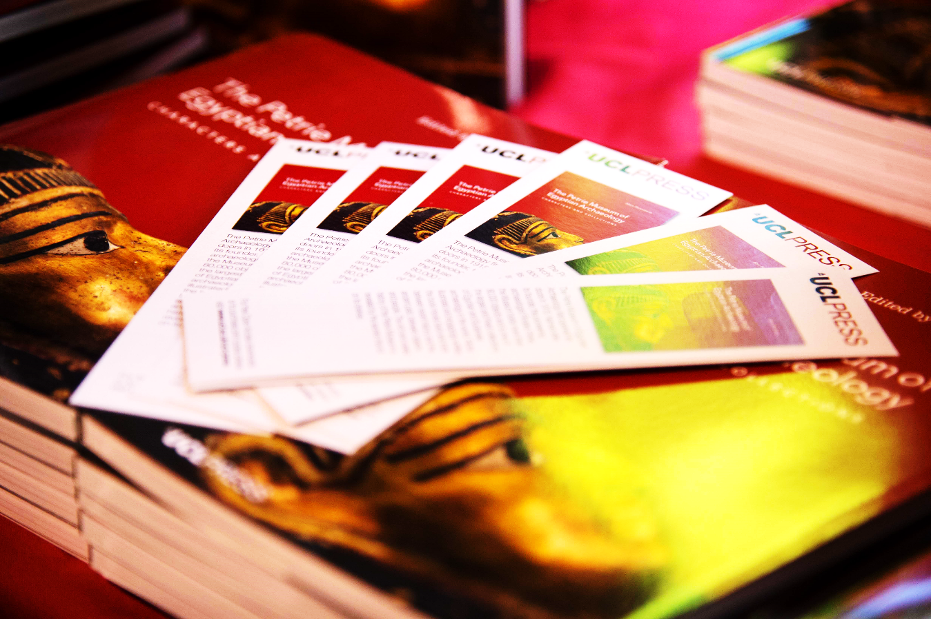
Challenges and Opportunities
Leadership role for Europe in Open Science
Platform for research data, publications, code
Facilitates sharing and re-use
Has potential to driver enterprise and economic growth
Opportunities
Commercial offerings compete with EOSC
Way universities engage with EOSC not yet clear
Understanding of RDM and FAIR data across academic community low
Funding for sustainability unclear
Challenges
Notes:
Elli: break up into two?

Slide 7
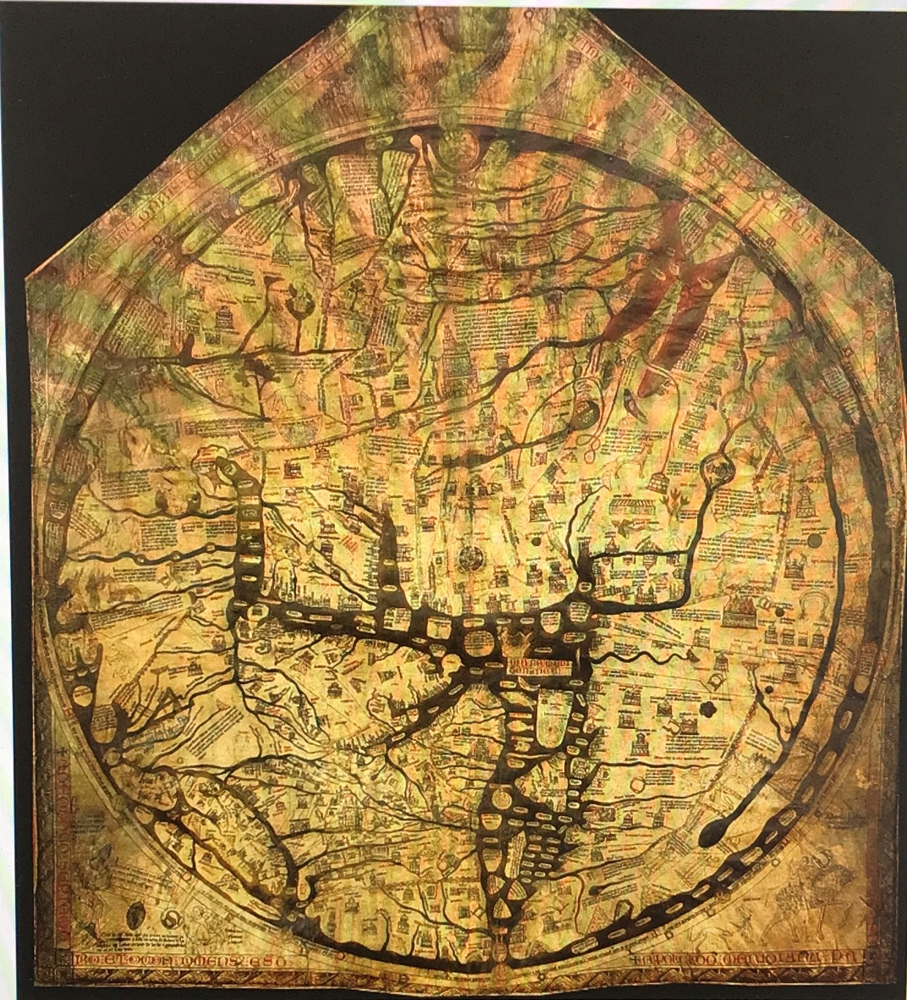
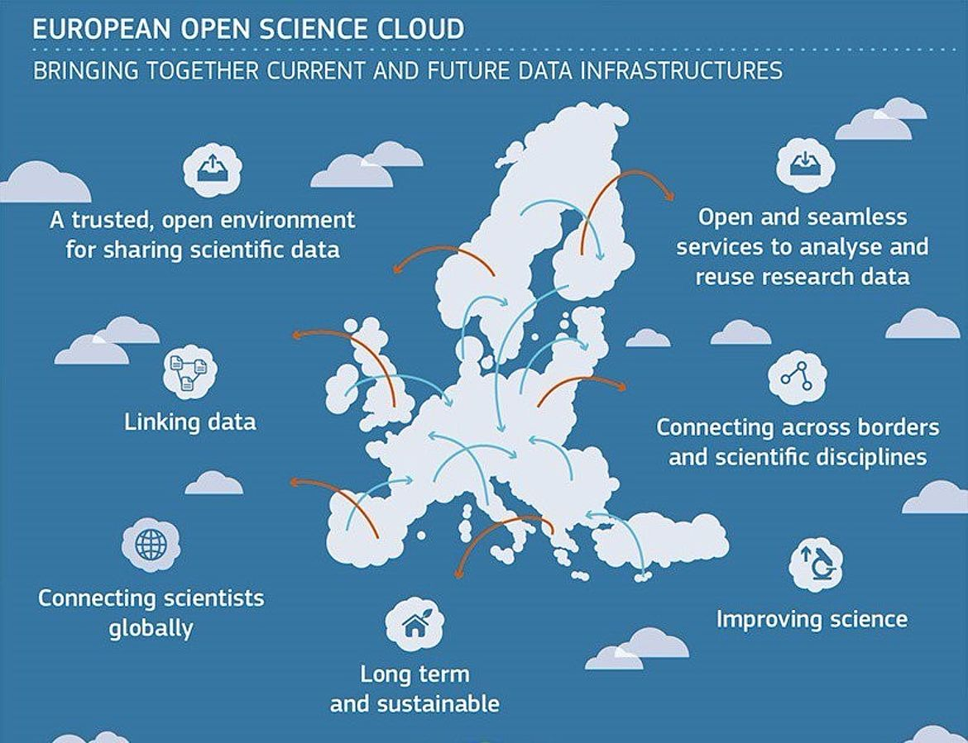
A pan-European Roadmap for Open Science?
Hereford ‘Mappa Mundi’
Largest surviving medieval map
A theological statement
Drawn in Lincoln c. 1300
But Africa is called Europe and vice versa…
England

