Slide 1



Importance of the EOSC
By Dra. Eva Méndez
Deputy Vice-president for Scientific Policy. Open Science
Universidad Carlos III de Madrid

Slide 2
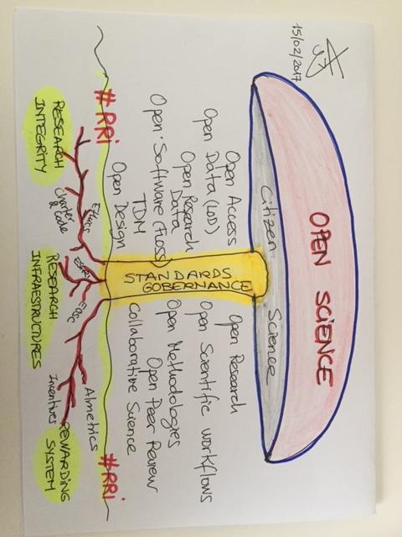

EOSC

Slide 3
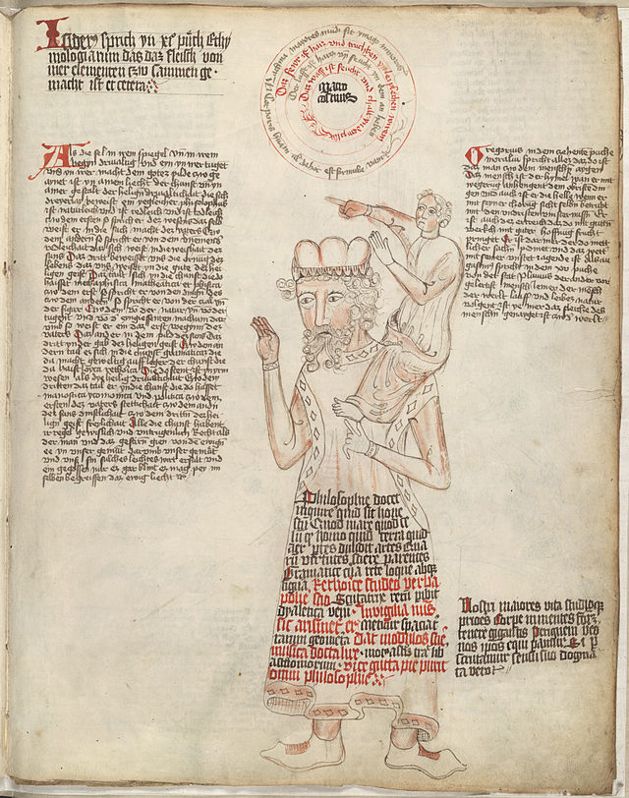
“If I have seen further it is by standing on the
shoulders
of giants”
Isaac Newton to Hooke (1676)
Notes:
Standing on the Shoulders of giants Wikipedia “This picture is derived from Greek mythology, where the blind giant Orion carried his servant Cedalion on his shoulders.”
Standing on the Shoulders of giants from Wikipedia “While it can be traced to at least the 12th century, attributed to Bernard of Chartres, [and is likely from Greek mythology] its most familiar expression in English is found in a 1676 letter of Isaac Newton to Hooke:
If I have seen further it is by standing on the shoulders of giants.”

Slide 4
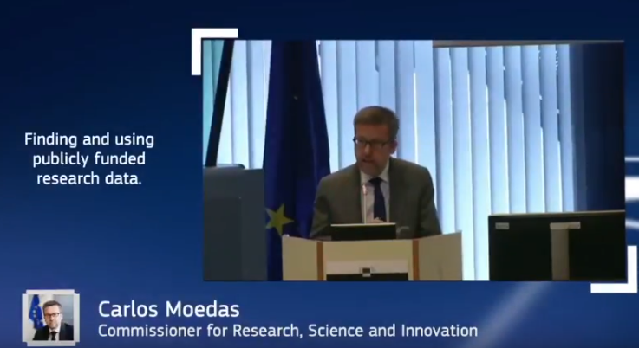
EOSC Summit, Brussels 12 June 2017

Slide 5
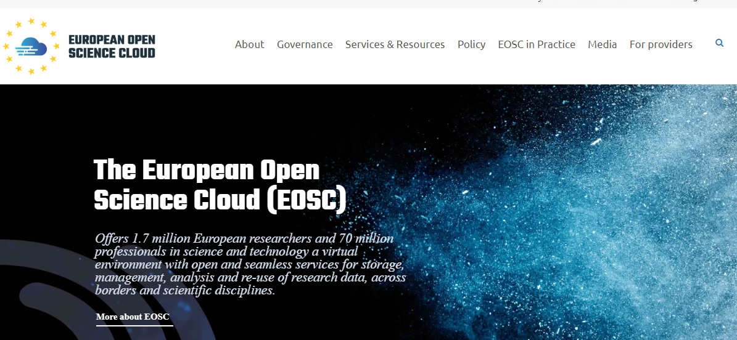

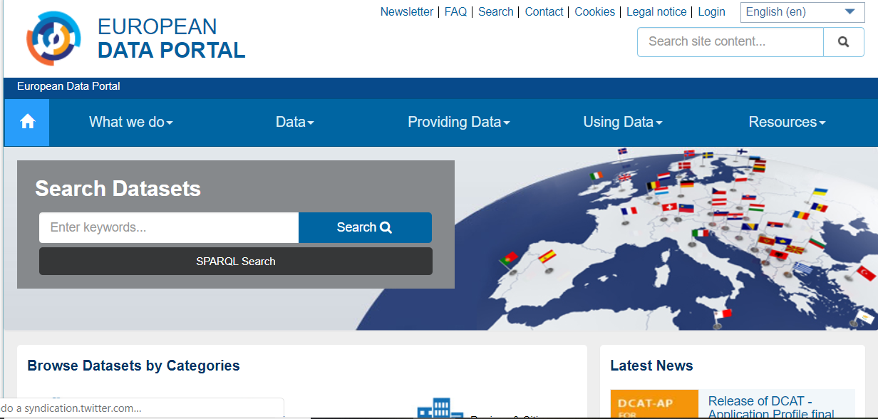

Gov
An objective: Reuse & Transparency (+)
A community
Rules and Standards
Infrastructures
Sci
An objective: Reuse & Reproducibility (+)
A community
Rules and Standards
Infrastructures

Slide 6

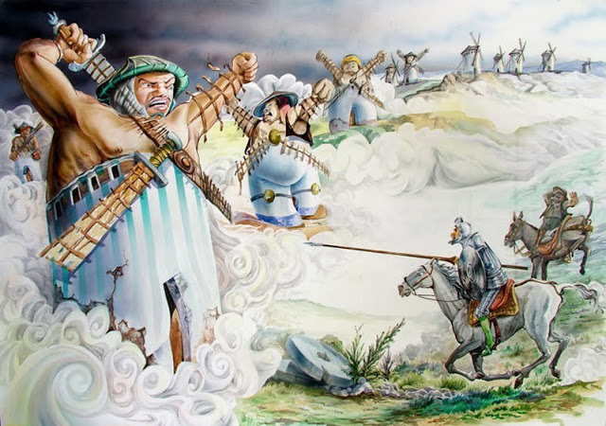
EOSC
https://www.microfilosofia.com/2017/08/molinos-de-viento-de-don-quijote.html

Slide 7

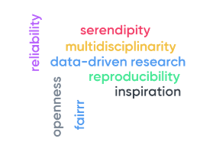
EOSC
Openness
Serendipity
FAIRRR
Reproducibility
Reliability
Inspiration
Data-driven research
Multidisciplinarity
Transparency / Engagement

Slide 8
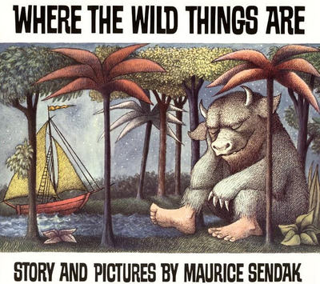
EOSC
Image from the children’s story by Maurice Sendak https://en.wikipedia.org/wiki/Where_the_Wild_Things_Are

