Slide 1
EOSC Portal
Vienna, 23 November

Slide 2
March 2018
November 2018
EOSC architecture as a federated system of resources and services from European digital infrastructures and national providers federated
EOSC is a “federating core” service contributing to the implementation of the “Access and interface” action line
of the EOSC roadmap
EOSC Launch Event | Vienna | 23rd Nov 2018

Slide 3
A delivery channel connecting the demand-side and the supply-side which showcases the potential of integrated and coordinated access to European services, data and other scientific outputs
https://eosc-portal.eu/
EOSC Launch Event | Vienna | 23rd Nov 2018

Slide 4
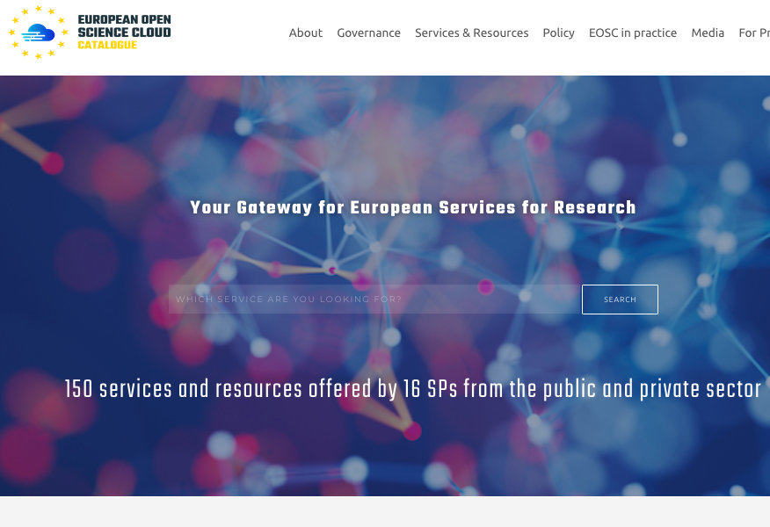
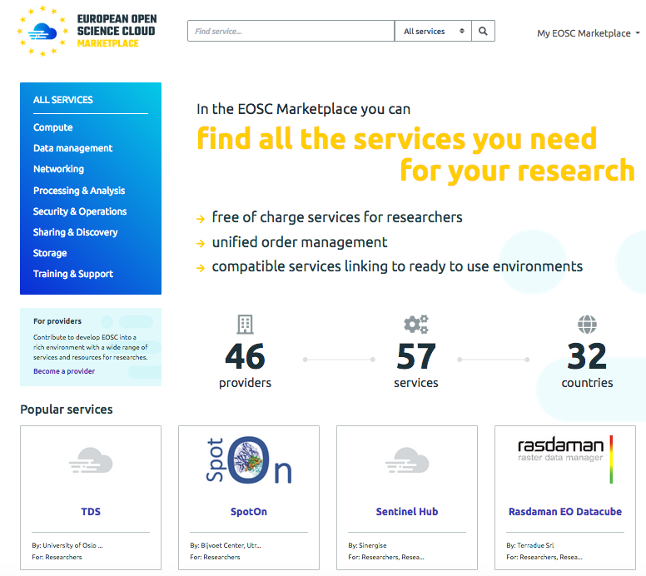
http://catalogue.eosc-portal.eu/home
https://marketplace.eosc-portal.eu/

Slide 5
EOSC Portal in action
Tracking on alien species to support policy making
Dr Gianpaolo Coro, Data Scientist
Consiglio Nazionale delle Ricerche, Italy
The CLARIN Use Case
Maciej Ogrodniczuk, Assistant professor
Institute of Computer Science, Polish Academy of Sciences

